Slide 1

ZİRAAT FAKÜLTESİ
Tarımsal Yapılar ve Sulama Bölümü
TYS-624 Yüzey Sulama Sistemlerinin Planlanması
Doç. Dr. Kadir Ersin TEMİZEL

Slide 2

Yüzey sulamaya ilişkin parametrelerin belirlenmesi
TYS-624 Yüzey Sulama Sistemlerinin Planlanması
Hafta-1

Slide 3
Surface Irrigation

Slide 4
Basic types
  flood retreat
  surface
    furrow
    border strip
    basin

Slide 5
Advantages and disadvantages
Advantages
the large expenditure on storage, headworks, and distribution canals is usually paid for by the Government, and the capital cost on the farm is low - this is an advantage (for the farmer) in the case of peasant agriculture:
surface irrigation may be more likely to be traditionally understood,
surface irrigation is more suitable for some crops, such as rice and forage crops;
leaching is easier and cheaper if it is needed
surface methods can use large flows available for short periods, and so allows canalised water supply to be easily shared by several farmers

Slide 6
Disadvantages
difficult to get even distribution of water on light permeable soils which have high infiltration rates;
surface irrigation is not suitable for crops which need frequent light watering (shallow rooted and/or drought susceptible crops);
efficient surface irrigation usually requires smooth land and if the land is not naturally smooth, it may be expensive to level it and the topsoil and fertility can be disturbed;
field layout for surface irrigation may restrict mechanisation unless special measures are adopted

Slide 7
Land levelling and its effects
Methods
grid surveys;
deep ripping;
land planes;
use of lasers

Slide 8
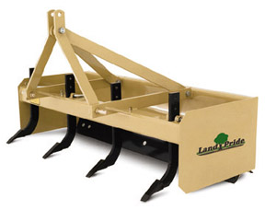

Slide 9
Land leveling

Slide 10
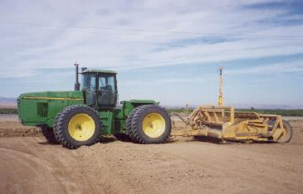

Slide 11
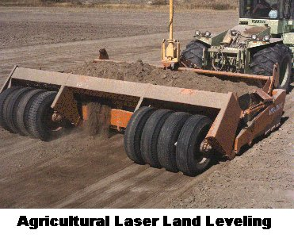

Slide 12
Some problems associated with land levelling
An example of the effect of exposing sub-soil on the
surface after land levelling on a field of cotton in
Iran.
Cut areas are where soil has been excavated.
Fill areas are where soil has been deposited during
land levelling

Slide 13
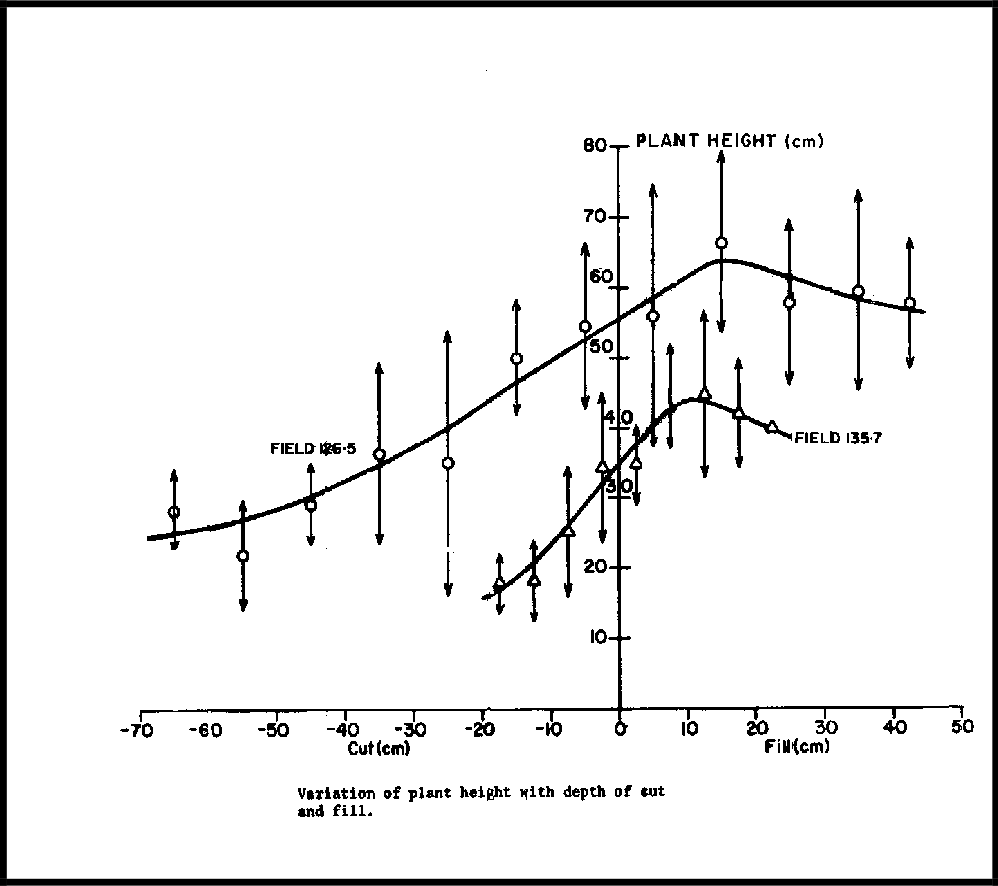

Slide 14
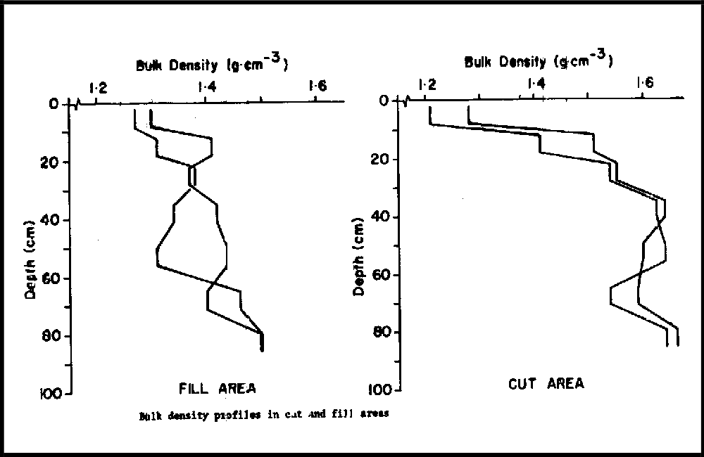

Slide 15
Flood retreat

Slide 16
Not really a method of irrigation but many people depend on flooding for crop production.
Problem often caused by dam construction such as in Kenya (Turkwell dam) - see New Sci. 18/6/87; p35

