Slide 1
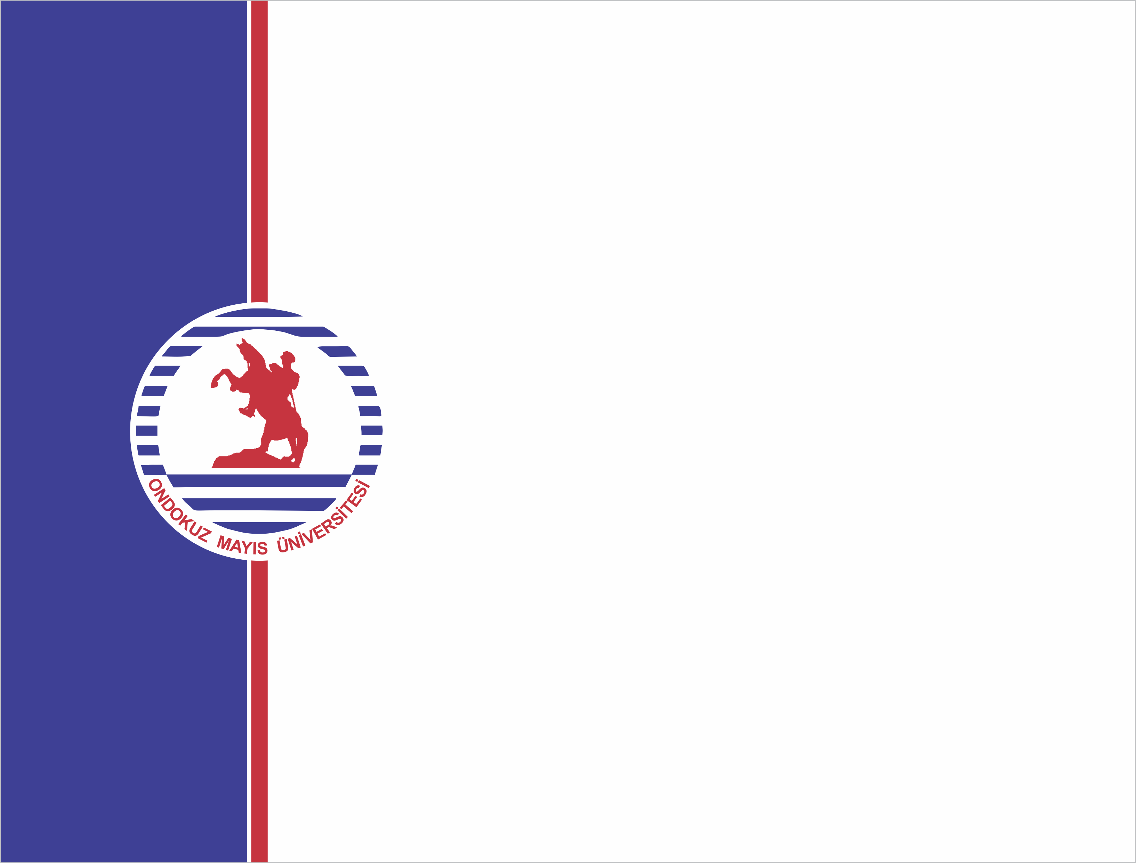
ZİRAAT FAKÜLTESİ
Tarımsal Yapılar ve Sulama Bölümü
TYS-624 Yüzey Sulama Sistemlerinin Planlanması
Doç. Dr. Kadir Ersin TEMİZEL

Slide 2
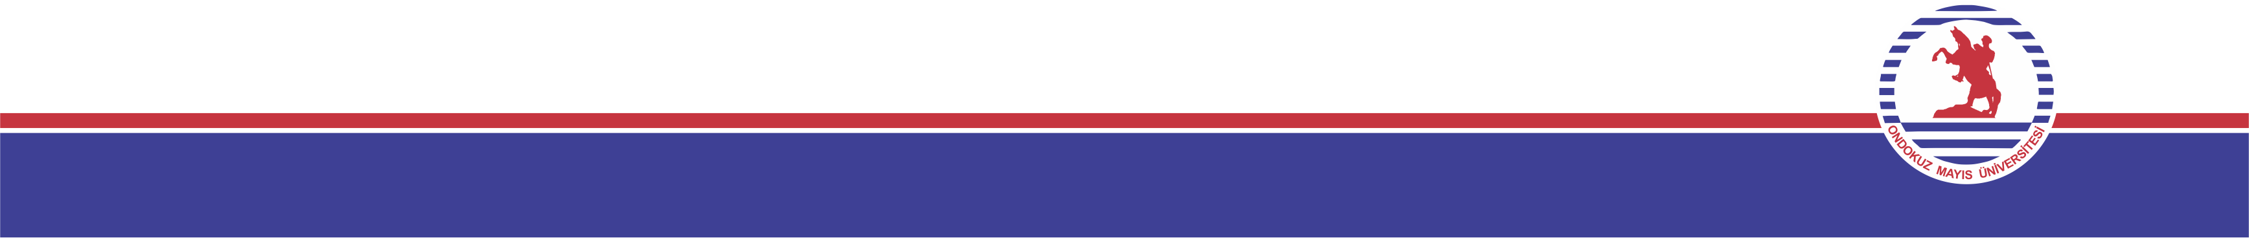
Border sulama yönteminin planlanması
TYS-624 Yüzey Sulama Sistemlerinin Planlanması
Hafta-10

Slide 3
3.2.2. Border Irrigation System
In a border irrigation, controlled surface flooding is practised whereby the field is divided up into strips by parallel ridges or dykes and each strip is irrigated separately by introducing water upstream and it progressively covers the entire strip.
Border irrigation is suited for crops that can withstand flooding for a short time e.g. wheat.
It can be used for all crops provided that the system is designated to provide the needed water control for irrigation of crops.
It is suited to soils between extremely high and very low infiltration rates.

Slide 4
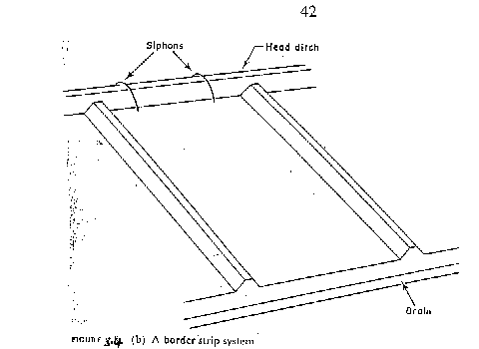
Border Irrigation System

Slide 5
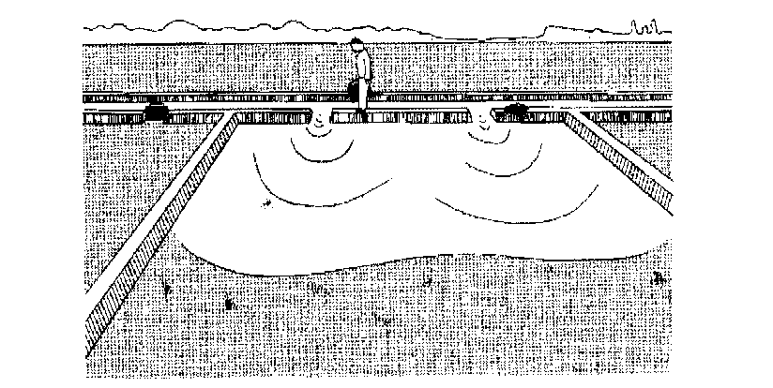
Border Irrigation

Slide 6
Border Irrigation Contd.
In border irrigation, water is applied slowly.
The root zone is applied water gradually down the field.
At a time, the application flow is cut-off to reduce water loses.
Ideally, there is no runoff and deep percolation.
The problem is that the time to cut off the inflow is difficult to determine.

Slide 7
3.2.2.2 Design Parameters of Border Irrigation System
a) Strip width: Cross slopes must be eliminated by leveling.
Since there are no furrows to restrict lateral movement, any cross slope will make water move down one side leading to poor application efficiency and possibly erosion.
The stream size available should also be considered in choosing a strip width.
The size should be enough to allow complete lateral spreading throughout the length of the strip.
The width of the strip for a given water supply is a function of the length (Table 3.5).
The strip width should be at least bigger than the size of vehicle tract for construction where applicable.

Slide 8
Design Parameters of Border Irrigation System Contd.
b) Strip Slope: Longitudinal slopes should be almost same as for the furrow irrigation.
c) Construction of Levees: Levees should be big enough to withstand erosion, and of sufficient height to contain the irrigation stream.
d) Selection of the Advance Stream: The maximum advance stream used should be non-erosive and therefore depends on the protection afforded by the crop cover. Clay soils are less susceptible to erosion but suffer surface panning at high water velocities. Table 3.4 gives the maximum flows recommendable for bare soils.
e) The Length of the Strip: Typical lengths and widths for various flows are given in Table 3.5. The ideal lengths can be obtained by field tests.

Slide 9
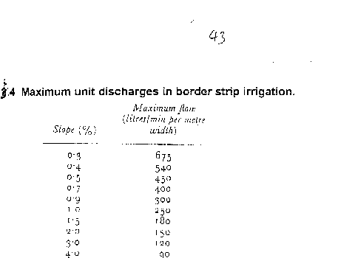
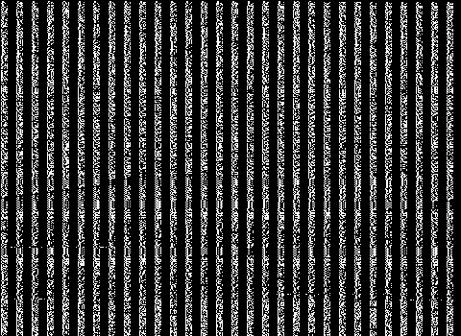

Slide 10
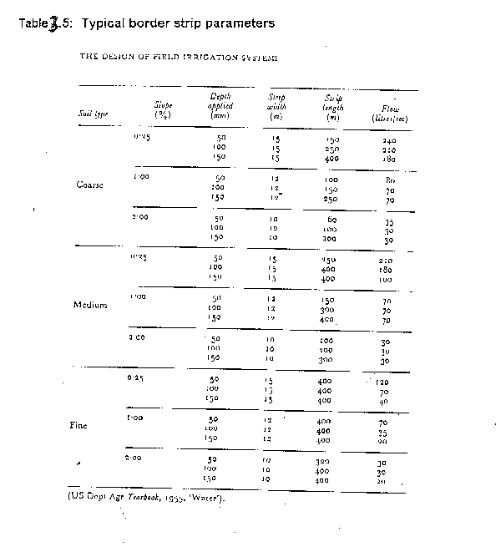

Slide 11
3.2.2.3 Evaluation of a Border Strip
The aim is to vary various parameters with the aim of obtaining a good irrigation profile.
Steps
a) Measure the infiltration rate of soils and get the cumulative infiltration curve. Measurement can be by double ring infiltrometer.
Depth of Water, D (mm)
D = KT^{n}
Time, T (mins)
Fig 3.5: Cumulative Infiltration Curve

Slide 12
Evaluation of Border Strip Contd.
b) Mark some points on the border strip and check the advance of water. Also check recession. For steep slopes, recession of water can be seen unlike in gentle slopes where it may be difficult to see. In border irrigation, recession is very important because unlike furrows, there is no place water can seep into after water is turned off.

Slide 13
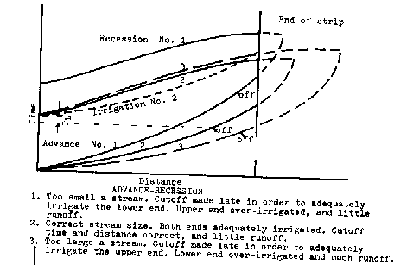
Time Distance Diagram of the Border System

Slide 14
Evaluation of the Border System Contd.
About two-thirds down the border, the flow is turned off and recession starts.
The difference between the advance and recession curves gives the opportunity time or total time when water is in contact with the soil.
For various distances, obtain the opportunity times from the advance/recession curves and from the cumulative infiltration curve, obtain the depths of water.
With the depth and distance data, plot the irrigation profile depth shown below.

Slide 15
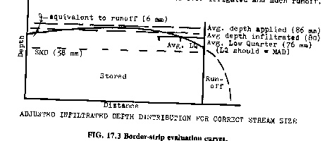
Depth- Distance Diagram of the Border System

Slide 16
Evaluation of the Border System Contd.
The depth of irrigation obtained is compared with the SMD (ideal irrigation depth).
There is deep percolation and runoff at the end of the field.
The variables can then be changed to give different shapes of graphs to see the one to reduce runoff and deep percolation. In this particular case above, the inflow can be stopped sooner. The recession curve then changes.
The profile now obtained creates deficiency at the ends of the borders (see graph: dotted lies above).
A good profile of irrigation can be obtained by varying the flow, which leads to a change in the recession curve, and by choosing a reasonable contact time each time using the infiltration curve.

