Slide 1

ZİRAAT FAKÜLTESİ
Tarımsal Yapılar ve Sulama Bölümü
TYS-624 Yüzey Sulama Sistemlerinin Planlanması
Doç. Dr. Kadir Ersin TEMİZEL

Slide 2

Tava sulama yönteminin planlanması
TYS-624 Yüzey Sulama Sistemlerinin Planlanması
Hafta-12

Slide 3
3.2.3 Basin Irrigation System
3.2.3.1 Description: In basin irrigation, water is flooded in wider areas. It is ideal for irrigating rice.
The area is normally flat.
In basin irrigation, a very high stream size is introduced into the basin so that rapid movement of water is obtained.
Water does not infiltrate a lot initially.
At the end, a bond is put and water can pond the field.
The opportunity time difference between the upward and the downward ends are reduced.

Slide 4
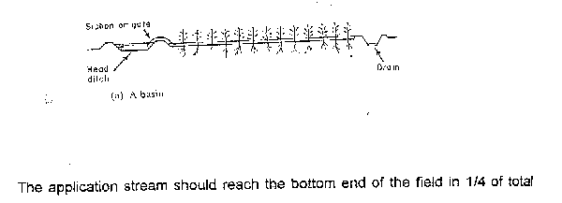
Basin Irrigation Diagram
I
rrigation time.

Slide 5
3.2.3.2 Size of Basins
The size of basin is related to stream size and soil type(See Table 3.6 below).
Table 3.6: Suggested basin areas for different soil types and rates of water flow
Flow rate Soil Type
Sand Sandy loam Clay loam Clay
l/s m³ /hr .................Hectares................................
30 108 0.02 0.06 0.12 0.20
60 216 0.04 0.12 0.24 0.40
90 324 0.06 0.18 0.36 0.60
120 432 0.08 0.24 0.48 0.80
150 540 0.10 0.30 0.60 1.00
180 648 0.12 0.36 0.72 1.20
210 756 0.14 0.42 0.84 1.40
240 864 0.16 0.48 0.96 1.60
300 1080 0.20 0.60 1.20 2.00
...........................................................................................
Note: The size of basin for clays is 10 times that of sand as the infiltration rate for clay is low leading to higher irrigation time. The size of basin also increases as the flow rate increases. The table is only a guide and practical values from an area should be relied upon. There is the need for field evaluation.

Slide 6
3.2.3.3 Evaluation of Basin System
a) Calculate the soil moisture deficiency and irrigation depth.
b) Get the cumulative infiltration using either single or double ring infiltrometer.
I = c T^{n}
Infiltered
Depth (mm)
Time (mins)

Slide 7
Evaluation of a Basin System Contd.
c) Get the advance curves using sticks to monitor rate of water movement. Plot a time versus distance graph (advance curve). Also plot recession curve or assume it to be straight
It is ensured that water reaches the end of the basin at T/4 time and stays T time before it disappears. At any point on the advance and recession curves, get the contact or opportunity time and relate it to the depth-time graph above to know the amount of water that has infiltrated at any distance.

Slide 8
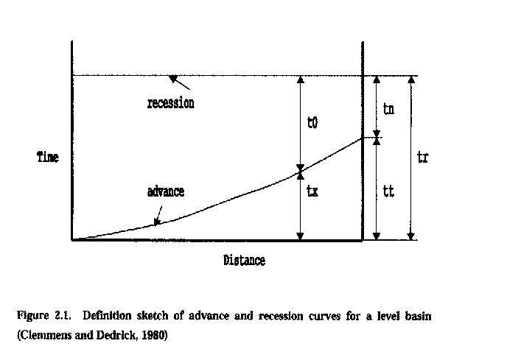
Time-Distance Graph of the Basin System

Slide 9
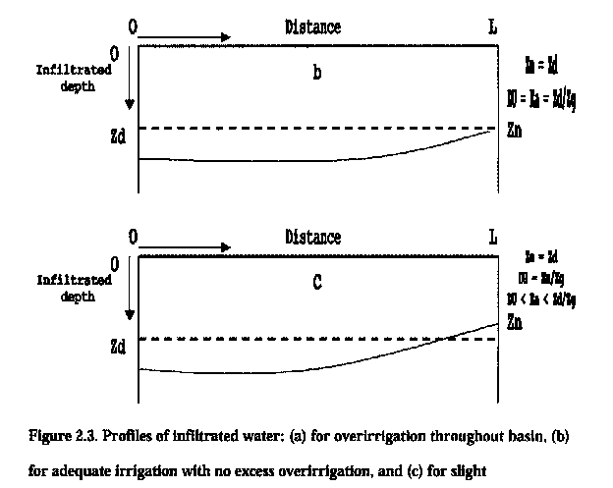
Depth-Distance Graphs of the Basin Irrigation System

Slide 10
Evaluation of Basin Irrigation Concluded.
Check the deficiency and decide whether improvements are necessary or not. The T/4 time can be increased or flow rate changed. The recession curve may not be a straight line but a curve due to some low points in the basin.

