Slide 1

ZİRAAT FAKÜLTESİ
Tarımsal Yapılar ve Sulama Bölümü
TYS-624 Yüzey Sulama Sistemlerinin Planlanması
Doç. Dr. Kadir Ersin TEMİZEL

Slide 2

Yüzey sulama yöntemlerinin planlanmasında kullanılan simulasyon programları
TYS-624 Yüzey Sulama Sistemlerinin Planlanması
Hafta-14

Slide 3
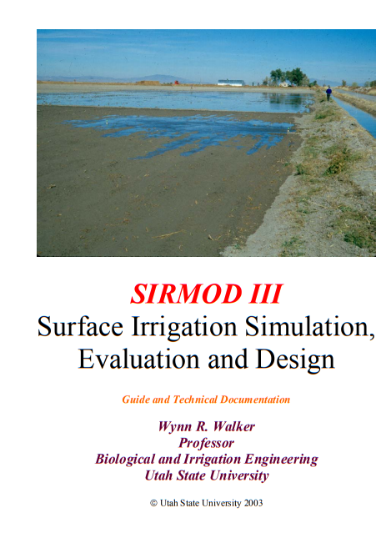
Yüzey sulama yöntemlerinin planlanmasında kullanılan simulasyon programları

Slide 4
performance is whether or not the system optimizes production and profitability on the farm. In order to index these factors in the surface irrigated environment, the following assumptions are made: 1. The crop root system extracts moisture from the soil uniformly with respect to depth and location; 2. The infiltration function for the soil is a unique relationship between infiltrated depth and the time water is in contact with the soil (intake opportunity time); and 3. The objective of irrigating is to completely refill the root zone. When a field with a uniform slope, soil and crop receives steady flow at its upper end, a water front will advance at a monotonically decreasing rate until it reaches the end of the field. If it is not diked, runoff will occur for a time before recession starts following shutoff of inflow. Figure 2.8 shows the distribution of applied water along the field length stemming from the assumptions listed above. The differences in intake opportunity time produce applied depths that are non-uniformly distributed with a characteristic shape skewed toward the inlet end of the field. Figure 2.8. Components of infiltrated water under surface irrigation. The amount of water that can be stored in the root zone is LZreq, but as shown, some region of the root zone has not received water owing to the spatial distribution of infiltration. The depth of water that would refill the root zone is Zreq, beyond which water percolates below the roots and is “lost”3 to the drainage or groundwater system. Computing each of these components requires a numerical integration of infiltrated depth over the field length. For the purposes of this discussion, it is convenient to define the components as follows: 3 Generally these flows return to receiving waters where they can be used elsewhere. Thus, they are lost in terms of the local condition but perhaps not to the regional or basin locale. The negative connotations of loss should be kept even though this water may be recovered and reused. The quality of these flows is nearly always degraded and the timing of when they are available elsewhere may not

