Slide 1

ZİRAAT FAKÜLTESİ
Tarımsal Yapılar ve Sulama Bölümü
TYS-624 Yüzey Sulama Sistemlerinin Planlanması
Doç. Dr. Kadir Ersin TEMİZEL

Slide 2

Yüzey sularının ölçümünde kullanılan aletler
TYS-624 Yüzey Sulama Sistemlerinin Planlanması
Hafta-5

Slide 3

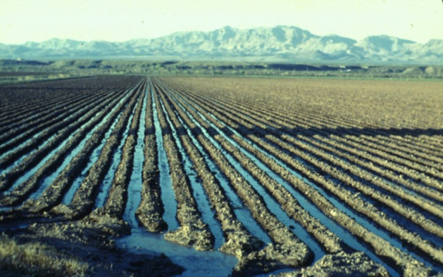
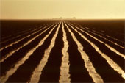
FURROW IRRIGATION

Slide 4
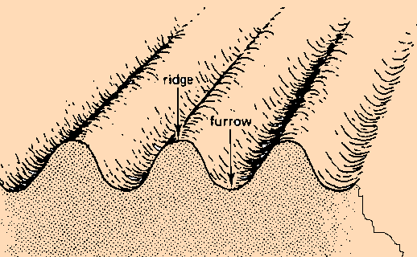
Furrow irrigation
The water is applied to the land through a series of long, narrow channels, called furrows.

Slide 5
The furrows are dug at a regular interval at right angle to the field channels.
The water flowing in the furrows infiltrates the soil and spreads laterally and reaches the roots of the plants between the furrows.

Slide 6
When to Use Furrow Irrigation
Furrow irrigation is suitable for a wide range of soil types, crops and land slopes

Slide 7
Suitable crops
Row crops such as maize, sunflower, sugarcane, soybean
Crops that would be damaged by inundation, such as tomatoes, vegetables, potatoes, beans
Fruit trees such as citrus, grape
Broadcast crops (corrugation method) such as wheat.

Slide 8
Suitable slopes
Uniform flat or gentle slopes are preferred
These should not exceed 0.5%.
Usually 0.05% furrow slope is provided to assist drainage following irrigation or excessive rainfall with high intensity
On undulating land furrows should follow the land contours

Slide 9
Suitable soils
Furrows can be used on most soil types
Very coarse sands are not recommended as percolation losses can be high
Soils that crust easily are especially suited to furrow irrigation

Slide 10
Furrow Layout
Furrow length
Furrow shape
Furrow spacing

Slide 11
Furrow length
Furrows must be on consonance with the slope, the soil type, the stream size, the irrigation depth, the cultivation practice and the field length.
The length varies from 30 to 60 m for sandy soil and 100 to 500 m for clayey soils.

Slide 12
Slope
The maximum recommended furrow slope is 0.5% to avoid soil erosion.
Furrows can also be level However a minimum grade of 0.05% is recommended so that effective drainage can occur.
If the land slope is steeper than 0.5% then furrows can be set along the contour to keep furrow slopes within the recommended limits.

Slide 13
If the main land slope exceeds 3% there is a major risk of soil erosion following a breach.
On steep land, terraces can also be constructed and furrows cultivated along the terraces

Slide 14
Soil type
In sandy soils water infiltrates rapidly
Furrows should be short (less than 110 a), so that water will reach the downstream end without excessive percolation losses.
In clay soils, the infiltration rate is much lower than in sandy soils. Furrows can be much longer on clayey than on sandy soils.

Slide 15
Stream size
The maximum stream size that will not cause erosion will depend on the furrow slope
It is advised not to use stream sizes larger than 3.0 l/sec

Slide 16
Non-erosive flow rate
The maximum non-erosive flow rate is estimated by the following empirical equation
q_{m} = 0.64/S
q_{m} = maximum non erosive stream , lps.
s = slope of furrow, %.

Slide 17
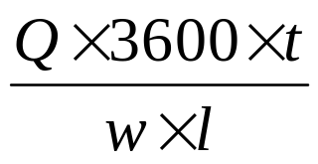
Irrigation depth
The average depth of water applied during an irrigation can be calculated from the following relationship:
d =
d = average depth of water applied, mm
Q = stream size , L/s
t = duration of irrigation, h
w = furrow spacing , m
l = furrow length, m

Slide 18
Cultivation practice
In mechanized farming furrows should be made as long as possible
Short furrows require a lot of attention as the flow must be changed frequently from one furrow to the next.
short furrows can be irrigated more efficiently than long ones as it is much easier to keep the percolation losses low.

Slide 19
Field length
PRACTICAL VALUES OF MAXIMUM FURROW LENGTHS (m) DEPENDING ON SLOPE, SOIL TYPE, STREAM SIZE AND NET IRRIGATION DEPTH
Furrow slope (%) | Maximum stream size (l/s) per furrow | Clay |  | Loam |  | Sand
 |  | Net irrigation depth (mm)
 |  | 50 | 75 | 50 | 75 | 50 | 75
0.0 | 3.0 | 100 | 150 | 60 | 90 | 30 | 45
0.1 | 3.0 | 120 | 170 | 90 | 125 | 45 | 60
0.2 | 2.5 | 130 | 180 | 110 | 150 | 60 | 95
0.3 | 2.0 | 150 | 200 | 130 | 170 | 75 | 110
0.5 | 1.2 | 150 | 200 | 130 | 170 | 75 | 110

Slide 20
Furrow shape
The shape of furrows is influenced by the
soil type
stream size

Slide 21
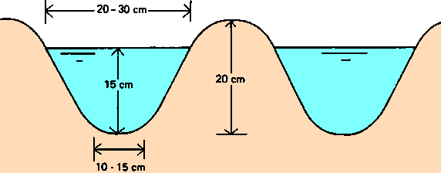
Soil type
Sandy soils
- water moves faster vertically than sideways.
-Narrow, deep V-shaped furrows are desirable.
-sandy soils are less stable, and tend to collapse, which may reduce the irrigation efficiency.
A deep, narrow furrow on a sandy soil

Slide 22
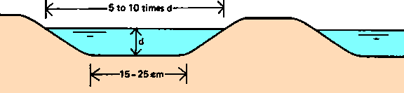
Clay soils
- more lateral movement of water and the infiltration rate is much less.
- wide, shallow furrow is desirable to obtain a large wetted area to encourage infiltration.
A wide, shallow furrow on a clay soil

Slide 23
Stream size
Larger the stream size the larger the furrow must be to contain the flow

Slide 24
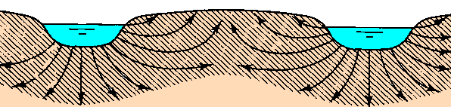
Furrow spacing
The Spacing Of Furrows Is Influenced By The Soil Type And The Cultivation Practice
Soil Type
Sandy soils- the spacing should be between 30 and 60 cm
Clay soils - spacing between two adjacent furrows 75-150 cm
Double-ridged furrows sometimes called beds can also be used.
A double-ridged furrow

Slide 25
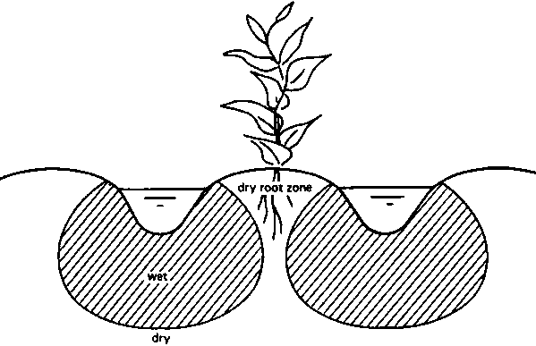
The spacing between two adjacent furrows is too wide

Slide 26
Wetting patterns
In order to obtain a uniformly wetted rootzone, furrows should be properly spaced, have a uniform slope and the irrigation water should be applied rapidly.
As the root zone in the ridge must be wetted from the furrows, the downward movement of water in the soil is less important than the lateral (or sideways) water movement. Both lateral and downward movement of water depends on soil type.

Slide 27
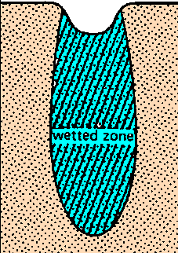
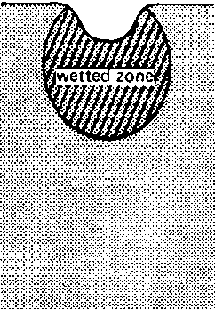

Different wetting patterns in furrows
SAND

Slide 28
Ideal wetting pattern
Adjacent wetting patterns overlap each other
There is an upward movement of water (capillary rise) that wets the entire ridge
For uniform water distribution along the furrow length uniform slope and a large enough stream size are necessary
The quarter time rule is used to determine the time required for water to travel from the farm channel to the end of the furrow.

Slide 29
Poor wetting patterns
Unfavorable natural conditions
-compacted layer, different soil types, uneven slope
Poor layout
-furrow spacing too wide
Poor management:
- supplying a stream size that is too large or too small, stopping the Inflow too soon

Slide 30
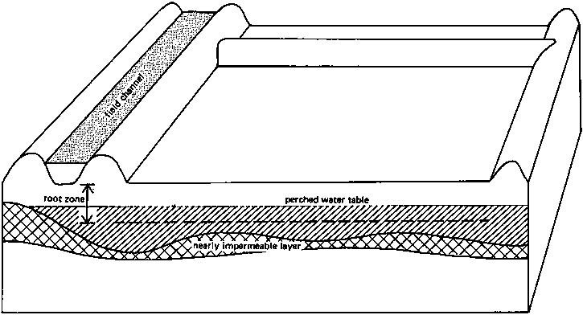
A nearly impermeable layer above which a perched water table is formed

Slide 31
spacing between two adjacent furrows is too wide

Slide 32
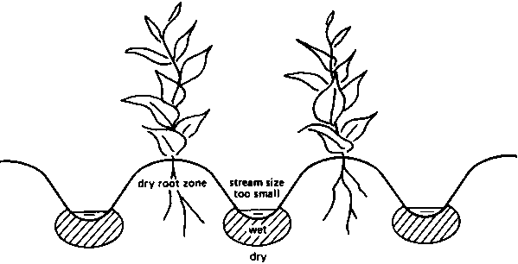
Stream size is too small to wet the ridge

Slide 33
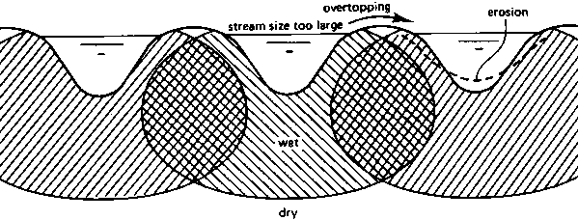
Stream size too large causing overtopping or erosion

Slide 34
Maintenance of Furrows
Furrow system should be maintained regularly
Water should reach the downstream end of all furrows
There should be no dry spots or water pondings
There should not be overtopping of ridges
Field channels and drains should be free from weeds

Slide 35
ADVANTAGES OF FURROW METHOD
The method is quite suitable for row crops such as maize, cotton, potatoes, sugar cane, sugar beet, groundnut, tobacco, etc.
The evaporation losses are smaller because only a part pf the land comes in contact with water.
The puddling heavy clayey soil is less in the furrows method. Hence, it is possible to cultivate soon after irrigation.
There is no wastage of land for the construction of the field channels required in other methods.
The cost of land preparation is less
6. Suitable for water logging sensitive crop like maize

