Slide 1

ZİRAAT FAKÜLTESİ
Tarımsal Yapılar ve Sulama Bölümü
TYS-624 Yüzey Sulama Sistemlerinin Planlanması
Doç. Dr. Kadir Ersin TEMİZEL

Slide 2

Yüzey sularının ölçümünde kullanılan aletler
TYS-624 Yüzey Sulama Sistemlerinin Planlanması
Hafta-7

Slide 3
Basic Hydraulics
Irrigation

Slide 4
Objectives:
Explain basic hydraulics
Describe the relationships between flow, velocity, and pressure
Determine pressure losses in pipe and fittings and pressures at various points in irrigation systems
Describe how to make efficient and economical irrigation design decisions
Explain how more uniform distribution of water cost less to install and maintain

Slide 5
Reasons to Learn
Why is it important to be able to understand basic hydraulics?
Why is it important to identify the relationships between flow, velocity and pressure?
Why is it important to determine pressure losses in pipe and fittings and pressures at various points in irrigation systems?
Why is it necessary to be able to make efficient and economical irrigation design decisions?
Why is it important to be able to explain how more uniform distribution of water cost less to install and maintain?

Slide 6
Questions to Answer
What do we need to know in order to be able to understand basic hydraulics?
What do we need to know to identify the relationships between flow, velocity and pressure?
What do we need to know to determine pressure losses in pipe and fittings and pressures at various points in irrigation systems?
What do we need to know to be able to make efficient and economical irrigation design decisions?
What do we need to know to be able to explain how more uniform distribution of water cost less to install and maintain?

Slide 7
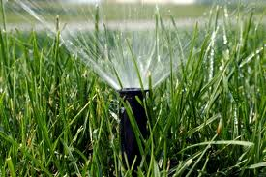
Introduction
Hydraulics is defined as a branch of science that deals with the effects of water or other liquids in motion.
Characteristics of water- in motion and at rest
Relationships between flow, velocity, and pressure
Pressure losses in pipe fittings
Pressures at various points in an irrigation system

Slide 8
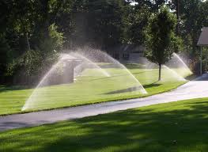
Introduction
Basic knowledge provides:
Ability to design and maintain economical and efficient irrigation systems
Systems that have a more uniform distribution of water
Cost less to install and maintain

Slide 9
Effects of Hydraulics
Water pressure affects sprinkler performance
Correct design will allow all sprinklers to operate correctly
Incorrect design will result in poor water distribution and a lack of uniform coverage
Consistent pressure is the primary goal of the design
This must be obtained at the lowest possible cost
Designing a system that uses the smallest and least amount of components is critical to keep costs down.
The system must however be able to conserve sufficient pressure to ensure optimal performance.

Slide 10
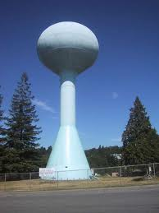
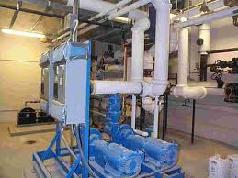
Water Pressure
Water pressure is created in two ways:
Using the weight of water (water tower)
The use of a pump (mechanical pressurization)

Slide 11
Water Pressure
Municipalities use both methods for the water we receive at home and business
Water tanks use gravity to produce pressure
Tanks are usually located on hill sides or built onto towers
The weight of the water and the force of gravity give the water it’s pressure
“booster” pumps can also be used to increase pressure where home may be higher than the tanks
Pumps are also used in ground and surface water retrieval

Slide 12
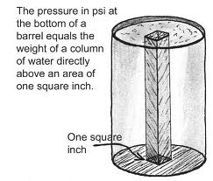
Water Pressure
Water pressure can be measured in several ways:
Psi or pounds per square inch – this is the most common expression
Feet oh head pressure or the equivalence of pressure at the bottom of a column of water 1 ft. high (ft./hd.)

Slide 13
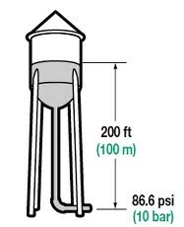
Water Pressure
Water creates pressure in landscape irrigation systems by the accumulated weight of water.
The weight of a 12in. high column of water weighs 0.433 lbs. (12in.³ x 0.00361 lbs. per in.³ = 0.433lbs.)
This relationship shows as our column gets higher every 1 ft. of height added will increase pressure at the bottom by 0.433 psi.

Slide 14
Water Pressure
Important Facts:
1 ft. column of water = 1 ft. of head pressure = 0.433 psi
1.0 psi equals the pressure created by a column of water 2.31 ft. high, or 1 psi = 2.31 ft. of head pressure (ft./hd.)
1 ft. column of water 1 ft. high creates 0.433 psi at the bottom, or 1 ft./hd. = 0.433 psi.

Slide 15
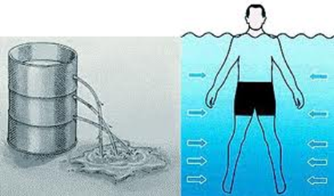
Shape or Size
The shape or size of a container does not make any difference in the pressure at the bottom
Pressure at an equal depth will be the same no matter what the size or shape of the container ( like diving into a pool vs. diving into a lake the pressure is the same as you descend)
All pressure is dependent upon the depth of the water

Slide 16
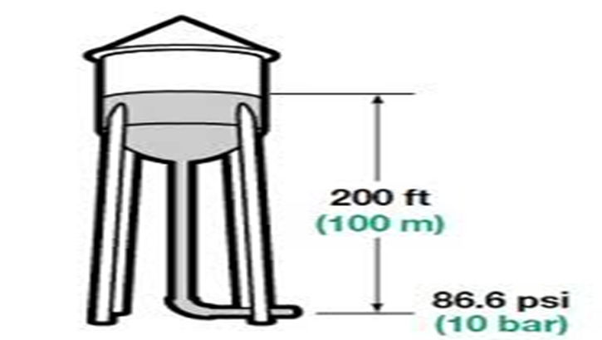
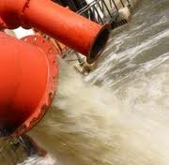
Static and Dynamic Pressure
There are two classifications of water pressure:
Static Pressure- is a measurement of water pressure when water is at rest.
Dynamic Pressure- (working pressure) measurement of water in motion

Slide 17
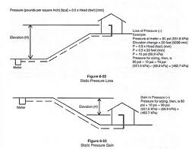
Static Pressure
Factors that affect static pressure:
Elevation change
Each ft. of elevation change results in 0.433 psi change in pressure
Static pressure is not affected by length of pipe only by elevation change.

Slide 18
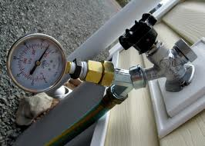
Static Pressure
Down hill
Static pressure is 60 psi control valve below the meter by 8ft. static pressure will be increased by 3.46 psi. (8ft. x 0.433 psi per foot = 3.46 psi) so 3.46 + 60 = 63.46 psi static pressure.

Slide 19
Static Pressure
Up hill
For every 1 ft. of vertical elevation gain static pressure will drop by 0.433 psi. Assume same beginning static pressure of 60 psi and a 40 ft. elevation increase. 40ft. x 0.433 psi/ft. = 17.32 psi so 60 – 17.32 = 42.68 psi

Slide 20
Dynamic pressure
Velocity- the speed at which water is moving, measured in feet per second (fps)
Flow- the amount of water moving through the system, measured in gallons per minute (gpm)
Dynamic water pressure like Static pressure is measured in psi

Slide 21
Dynamic pressure
Factors that affect dynamic pressure:
Change in elevation
Friction losses in pipe, fittings and valves (caused b water moving through system)
Velocity head pressure (pressure required to make water move within the system, this is a minor loss)
Entrance losses ( pressure lost as water flows through openings; also a minor loss)

Slide 22
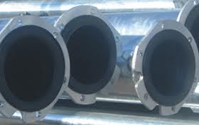
Friction loss in pipe
After static pressure is determined we then subtract the pressure losses due to the movement of water
Friction losses- refers to water moving through the system, the pressure lost by turbulence in pipes, valves, and fittings

Slide 23
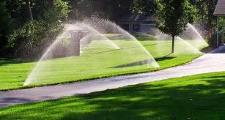
Friction loss in pipe
4 factors:
Velocity of water
Inside diameter of the pipe
The roughness of the inside of the pipe
The length of the pipe

Slide 24
Friction loss in pipe
Increasing velocity will cause increased turbulence and increased pressure losses
With the increase in velocity (fps) there is a corresponding increase in flow (gpm)
Velocity and flow are directly related an increase or decrease in one will result in the same of the other
When velocity increases, pressure loss increases

Slide 25
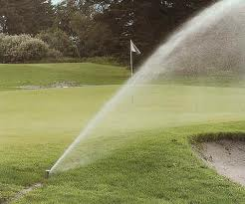
Friction loss in pipe
Velocity typically increases when:
The flow is increased such as when sprinklers are added to an existing line
A smaller pipe is used with the same flow (gpm)

Slide 26
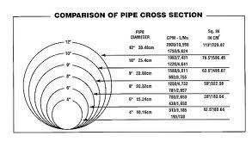
Inside Diameter (i.d.)
Smaller i.d. proportionally increases the amount of water in contact with the pipe surface.
This contact increases turbulence thus increasing dynamic pressure loss
Even with a smaller flow and the same velocity more turbulence is created in smaller pipes because there is a greater percentage of water in contact with pipe surface

Slide 27
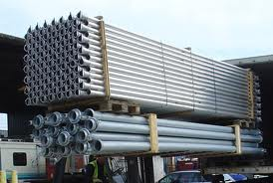
Roughness
The inside wall of the pipe affects friction loss in pipe
Roughness is rated by a “C” factor
The lower the C the rougher the pipe (steel pipe – C = 100, pvc – C = 150)
The rougher the inside, the more turbulence and greater friction loss

Slide 28
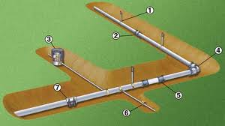
Length
The greater the distance, the greater the cumulative effect on the preceding factors of velocity, i.d., and roughness
There is a direct relationship between length and increased pressure loss
The total pressure loss doubles as the length of the pipe doubles

Slide 29
Length
Several formulas for calculating pressure loss have been established:
The most common is the Hazen-Williams formula:
Hf = 0.090194 (100 / C) 1.852 x (Q 1.852 / d 4.866)
Where: Hf = pressure loss in pounds per square inch (psi)
C = roughness factor
Q = flow in gallons per minute (gpm)
d = inside diameter of pipe in inches
These formulas are good to know however charts are available for ease of calculation

Slide 30
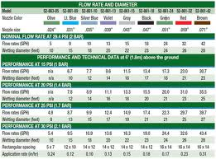
Charts
Determine pressure loss in pipe due to friction loss
Determine the velocity at various flow rates
Use pressure losses and/or velocities to determine pipe size

Slide 31
Charts
Using the chart:
Find the flow of water in gpm on the left column
Scan across the top to locate pipe size
Read down this column, under the “psi loss” heading, and across the row for the gpm
Multiply this number by 100 to find the psi per foot
Multiply this number by the length of pipe ft.
Ex. Find friction loss in 42ft. of ¾ in. class 200 pvc flowing 6 gpm
1.67 / 100 = .0167 psi pressure loss
0.0167 x 42 ft. = 0.701

Slide 32
Summary
Water pressure is created by?
Water pressure can be measured in?
For every one foot of elevation change the water pressure does what?

