Slide 1

ZİRAAT FAKÜLTESİ
Tarımsal Yapılar ve Sulama Bölümü
TYS-624 Yüzey Sulama Sistemlerinin Planlanması
Doç. Dr. Kadir Ersin TEMİZEL

Slide 2

Açık kanallaarda planlama –Temel Hidrolik
TYS-624 Yüzey Sulama Sistemlerinin Planlanması
Hafta-8

Slide 3
CHAPTER THREE: IRRIGATION METHODS AND DESIGNS
3.1 IRRIGATION METHODS
a) Surface Irrigation: Just flooding water. About 90% of the irrigated areas in the world are by this method.
b) Sprinkler Irrigation: Applying water under pressure. About 5 % of the irrigated areas are by this method.
c) Drip or Trickle Irrigation: Applying water slowly to the soil ideally at the same rate with crop consumption.
d) Sub-Surface Irrigation: Flooding water underground and allowing it to come up by capillarity to crop roots.

Slide 4
3.2 SURFACE IRRIGATION
Water is applied to the field in either the controlled or uncontrolled manner.
Controlled: Water is applied from the head ditch and guided by corrugations, furrows, borders, or ridges.
Uncontrolled: Wild flooding.
Surface irrigation is entirely practised where water is abundant. The low initial cost of development is later offset by high labour cost of applying water. There are deep percolation, runoff and drainage problems

Slide 5
3.2.1 Furrow Irrigation
In furrow irrigation, only a part of the land surface (the furrow) is wetted thus minimizing evaporation loss.
Furrow irrigation is adapted for row crops like corn, banana, tobacco, and cabbage. It is also good for grains.
Irrigation can be by corrugation using small irrigation streams.
Furrow irrigation is adapted for irrigating on various slopes except on steep ones because of erosion and bank overflow.

Slide 6
Furrow Irrigation Contd.
There are different ways of applying water to the furrow.
As shown in Fig. 3.1, siphons are used to divert water from the head ditch to the furrows.
There can also be direct gravity flow whereby water is delivered from the head ditch to the furrows by cutting the ridge or levee separating the head ditch and the furrows (see diagram from Gumb's book).
Gated pipes can also be used. Large portable pipe(up to 450 mm) with gate openings spaced to deliver water to the furrows are used.
Water is pumped from the water source in closed conduits.
The openings of the gated pipe can be regulated to control the discharge rate into the furrows.

Slide 7
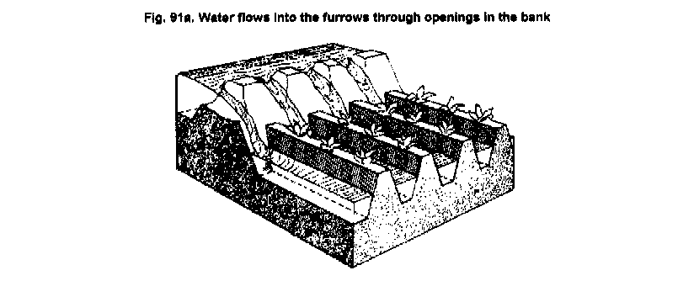
Furrow Irrigation by Cutting the Ridge

Slide 8
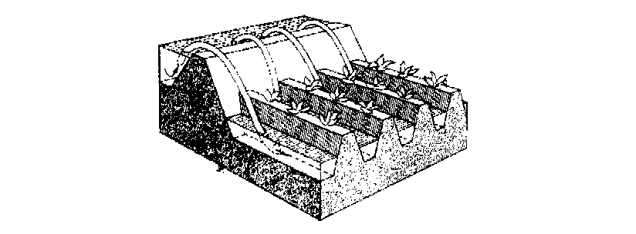
Furrow Irrigation with Siphons

Slide 9
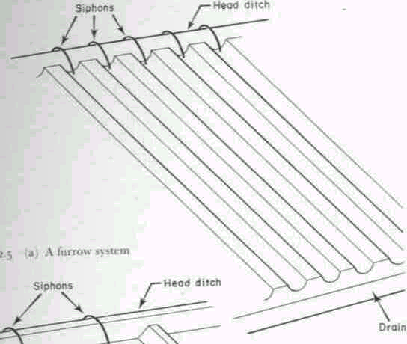
Fig. 3.1: A Furrow System

Slide 10
3.2.1.1 Design Parameters of Furrow Irrigation
The Major Design Considerations in Surface Irrigation Include:
Storing the Readily Available Moisture in the Root Zone, if Possible;
Obtaining As Uniform Water Application As Possible;
Minimizing Soil Erosion by Applying Non-erosive Streams;
Minimizing Runoff at the End of the Furrow by Using a Re-use System or a Cut -Back Stream;
Minimizing Labour Requirements by Having Good Land Preparation,
Good Design and Experienced Labour and
Facilitating Use of Machinery for Land Preparation, Cultivation, Furrowing, Harvesting Etc.

Slide 11
Furrow Irrigation Contd.
The Specific Design Parameters of Furrow Irrigation Are Aimed at Achieving the Above Objectives and Include:
a) Shape and Spacing of Furrows: Heights of ridges vary between 15 cm and 40 cm and the distance between the ridges should be based on the optimum crop spacing modified, if necessary to obtain adequate lateral wetting, and to accommodate the track of mechanical equipment.
The range of spacing commonly used is from 0.3 to 1.8 m with 1.0 m as the average.

Slide 12
Design Parameters of Furrow Irrigation Contd.
b) Selection of the Advance or Initial Furrow Stream: In permeable soils, the maximum non-erosive flow within the furrow capacity can be used so as to enable wetting of the end of the furrow to begin as soon as possible.
The maximum non-erosive flow (Q_{m}) is given by: Q_{m} = c/S where c is a constant = 0.6 when Q_{m} is in l/s and S is slope in %.
Example 1: For a soil slope of 0.1 %, the Q_{m} is 0.6/0.1 = 6 l/s.

Slide 13
Design Parameters of Furrow Irrigation Contd.
The actual stream size should be determined by field tests.
It is desirable that this initial stream size reaches the end of the furrow in T/4 time where T is the total time required to apply the required irrigation depth.
c) Cut-back Stream: This is the stream size to which the initial stream is reduced sometime after it has reached the lower end of the field.
This is to reduce soil erosion.
One or two cutbacks can be carried out and removing some siphons or reducing the size at the head of the furrow achieves this.

Slide 14
Design Parameters of Furrow Irrigation Contd.
d) Field Slope: To reduce costs of land grading, longitudinal and cross slopes should be adapted to the natural topography.
Small cross slopes can be tolerated.
To reduce erosion problems during rainfall, furrows (which channel the runoff) should have a limited slope (see Table 3.1).

Slide 15
Table 3.1 : Maximum Slopes for Various Soil Types
Soil Type Maximum slopes*
Sand 0.25
Sandy loam 0.40
Fine sandy loam 0.50
Clay 2.50
Loam 6.25 Source: Withers & Vipond (1974)
*A minimum slope of about 0.05 % is required to ensure surface drainage.

Slide 16
Design Parameters of Furrow Irrigation Contd.
e) Furrow Length: Very long lengths lead to a lot of deep percolation involving over-irrigation at the upper end of the furrow and under-irrigation at the lower end.
Typical values are given in Table 3.2, but actual furrow lengths should be got from field tests.

Slide 17
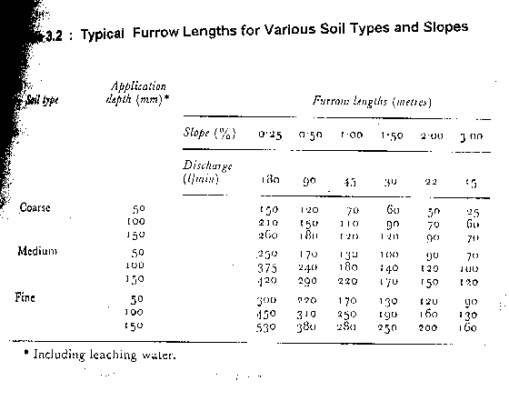

Slide 19
Design Parameters of Furrow Irrigation Contd.
e) Field Widths: Widths are flexible but should not be of a size to enclose variable soil types.
The widths should depend on land grading permissible.

Slide 20
3.2.1.2 Evaluation of a Furrow Irrigation System
The objective is to determine fairly accurately how the system is used and to suggest possible amendments or changes.
Equipment: Engineers Level and Staff,
30 m Tape,
Marker Stakes,
Siphons of Various Sizes,
Two Small Measuring Flumes,
Watch with Second Hand and Spade.

Slide 21
Evaluation of a Furrow Irrigation System Contd.
Procedure
a) Select several (say 3 or more) uniform test furrows which should be typical of those in the area.
b) Measure the average furrow spacing and note the shape, condition etc.
c) Set the marker stakes at 30 m intervals down the furrows.
d) Take levels at each stake and determine the average slope.
e) Set the flumes say 30 m apart at the head of the middle furrow.
f) Pass constant flow streams down the furrows, using wide range of flows. The largest flow should just cause erosion and overtopping, the smallest might just reach the end of the furrow. The median stream should have a discharge of about Q = 3/4 S (l/s) where S is the % slope.

Slide 22
Evaluation of a Furrow Irrigation System Contd.
g) Record the time when flow starts and passes each marker in each flow(advance data).
h) Record the flow at each flume periodically until the flows become practically constant. This may take several hours on fine textured soils(Infiltration data).
i) Check for evidence of erosion or overtopping.
j) Move the flumes and measure the streams at the heads only of the other furrows.
Results: To be presented in a format shown:
............................................................................................................
Watch Opportunity time(mins)
Station A Station B Losses
Time A B C Depth Flow Depth Flow Diff Infil.
(mm) ( L/s) (mm) (L/s) (L/s) (mm/h)
..............................................................................................................
Notes:
Solve problem in note.

Slide 23
3.2.2. Border Irrigation System
In a border irrigation, controlled surface flooding is practised whereby the field is divided up into strips by parallel ridges or dykes and each strip is irrigated separately by introducing water upstream and it progressively covers the entire strip.
Border irrigation is suited for crops that can withstand flooding for a short time e.g. wheat.
It can be used for all crops provided that the system is designated to provide the needed water control for irrigation of crops.
It is suited to soils between extremely high and very low infiltration rates.

Slide 24
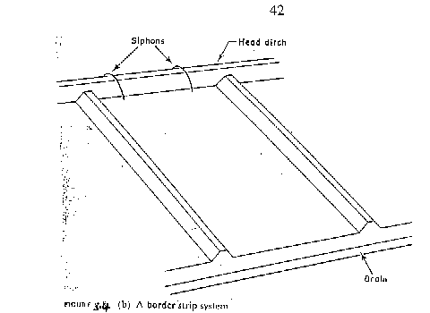
Border Irrigation System

Slide 25
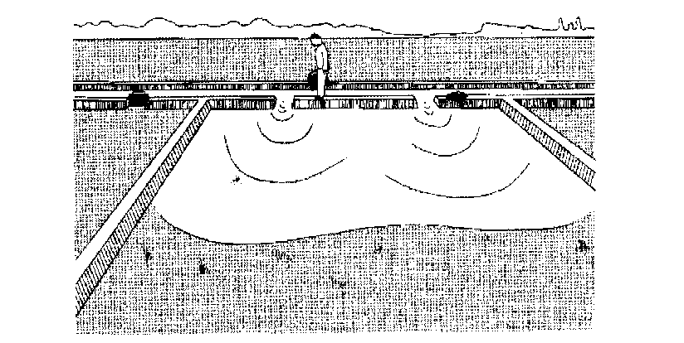
Border Irrigation

Slide 26
Border Irrigation Contd.
In border irrigation, water is applied slowly.
The root zone is applied water gradually down the field.
At a time, the application flow is cut-off to reduce water loses.
Ideally, there is no runoff and deep percolation.
The problem is that the time to cut off the inflow is difficult to determine.

Slide 27
3.2.2.2 Design Parameters of Border Irrigation System
a) Strip width: Cross slopes must be eliminated by leveling.
Since there are no furrows to restrict lateral movement, any cross slope will make water move down one side leading to poor application efficiency and possibly erosion.
The stream size available should also be considered in choosing a strip width.
The size should be enough to allow complete lateral spreading throughout the length of the strip.
The width of the strip for a given water supply is a function of the length (Table 3.5).
The strip width should be at least bigger than the size of vehicle tract for construction where applicable.

Slide 28
Design Parameters of Border Irrigation System Contd.
b) Strip Slope: Longitudinal slopes should be almost same as for the furrow irrigation.
c) Construction of Levees: Levees should be big enough to withstand erosion, and of sufficient height to contain the irrigation stream.
d) Selection of the Advance Stream: The maximum advance stream used should be non-erosive and therefore depends on the protection afforded by the crop cover. Clay soils are less susceptible to erosion but suffer surface panning at high water velocities. Table 3.4 gives the maximum flows recommendable for bare soils.
e) The Length of the Strip: Typical lengths and widths for various flows are given in Table 3.5. The ideal lengths can be obtained by field tests.

Slide 29
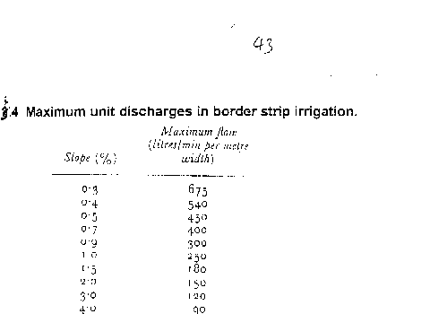
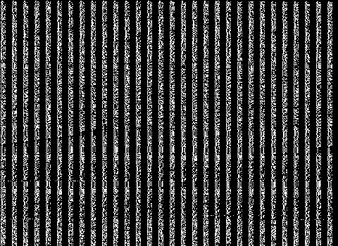

Slide 30
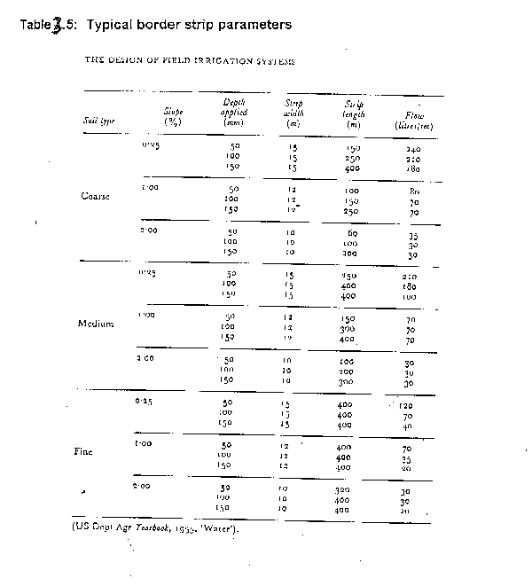

Slide 31
3.2.2.3 Evaluation of a Border Strip
The aim is to vary various parameters with the aim of obtaining a good irrigation profile.
Steps
a) Measure the infiltration rate of soils and get the cumulative infiltration curve. Measurement can be by double ring infiltrometer.
Depth of Water, D (mm)
D = KT^{n}
Time, T (mins)
Fig 3.5: Cumulative Infiltration Curve

Slide 32
Evaluation of Border Strip Contd.
b) Mark some points on the border strip and check the advance of water. Also check recession. For steep slopes, recession of water can be seen unlike in gentle slopes where it may be difficult to see. In border irrigation, recession is very important because unlike furrows, there is no place water can seep into after water is turned off.

Slide 33
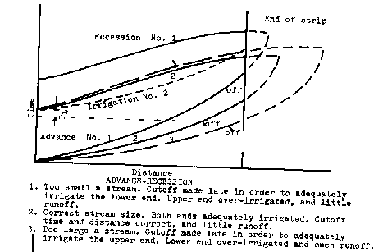
Time Distance Diagram of the Border System

Slide 34
Evaluation of the Border System Contd.
About two-thirds down the border, the flow is turned off and recession starts.
The difference between the advance and recession curves gives the opportunity time or total time when water is in contact with the soil.
For various distances, obtain the opportunity times from the advance/recession curves and from the cumulative infiltration curve, obtain the depths of water.
With the depth and distance data, plot the irrigation profile depth shown below.

Slide 35
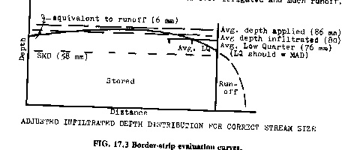
Depth- Distance Diagram of the Border System

Slide 36
Evaluation of the Border System Contd.
The depth of irrigation obtained is compared with the SMD (ideal irrigation depth).
There is deep percolation and runoff at the end of the field.
The variables can then be changed to give different shapes of graphs to see the one to reduce runoff and deep percolation. In this particular case above, the inflow can be stopped sooner. The recession curve then changes.
The profile now obtained creates deficiency at the ends of the borders (see graph: dotted lies above).
A good profile of irrigation can be obtained by varying the flow, which leads to a change in the recession curve, and by choosing a reasonable contact time each time using the infiltration curve.

Slide 37
3.2.3 Basin Irrigation System
3.2.3.1 Description: In basin irrigation, water is flooded in wider areas. It is ideal for irrigating rice.
The area is normally flat.
In basin irrigation, a very high stream size is introduced into the basin so that rapid movement of water is obtained.
Water does not infiltrate a lot initially.
At the end, a bond is put and water can pond the field.
The opportunity time difference between the upward and the downward ends are reduced.

Slide 38
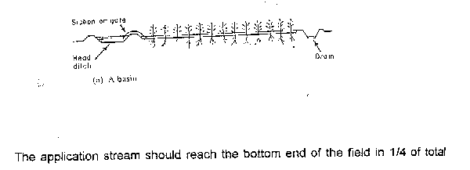
Basin Irrigation Diagram
I
rrigation time.

Slide 39
3.2.3.2 Size of Basins
The size of basin is related to stream size and soil type(See Table 3.6 below).
Table 3.6: Suggested basin areas for different soil types and rates of water flow
Flow rate Soil Type
Sand Sandy loam Clay loam Clay
l/s m³ /hr .................Hectares................................
30 108 0.02 0.06 0.12 0.20
60 216 0.04 0.12 0.24 0.40
90 324 0.06 0.18 0.36 0.60
120 432 0.08 0.24 0.48 0.80
150 540 0.10 0.30 0.60 1.00
180 648 0.12 0.36 0.72 1.20
210 756 0.14 0.42 0.84 1.40
240 864 0.16 0.48 0.96 1.60
300 1080 0.20 0.60 1.20 2.00
...........................................................................................
Note: The size of basin for clays is 10 times that of sand as the infiltration rate for clay is low leading to higher irrigation time. The size of basin also increases as the flow rate increases. The table is only a guide and practical values from an area should be relied upon. There is the need for field evaluation.

Slide 40
3.2.3.3 Evaluation of Basin System
a) Calculate the soil moisture deficiency and irrigation depth.
b) Get the cumulative infiltration using either single or double ring infiltrometer.
I = c T^{n}
Infiltered
Depth (mm)
Time (mins)

Slide 41
Evaluation of a Basin System Contd.
c) Get the advance curves using sticks to monitor rate of water movement. Plot a time versus distance graph (advance curve). Also plot recession curve or assume it to be straight
It is ensured that water reaches the end of the basin at T/4 time and stays T time before it disappears. At any point on the advance and recession curves, get the contact or opportunity time and relate it to the depth-time graph above to know the amount of water that has infiltrated at any distance.

Slide 42
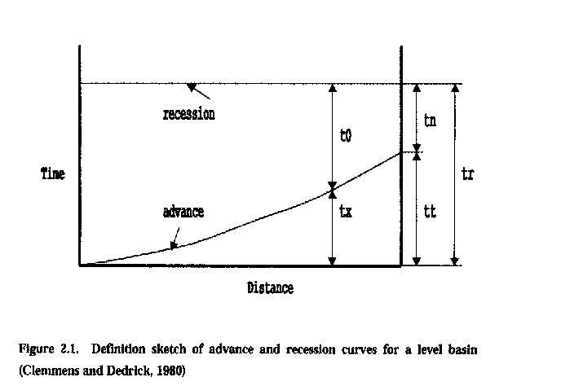
Time-Distance Graph of the Basin System

Slide 43
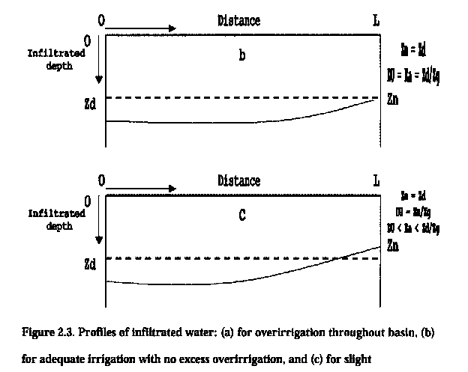
Depth-Distance Graphs of the Basin Irrigation System

Slide 44
Evaluation of Basin Irrigation Concluded.
Check the deficiency and decide whether improvements are necessary or not. The T/4 time can be increased or flow rate changed. The recession curve may not be a straight line but a curve due to some low points in the basin.

Slide 45
3.3 SPRINKLER IRRIGATION
3.3.1 Introduction: The sprinkler system is ideal in areas where water is scarce.
A Sprinkler system conveys water through pipes and applies it with a minimum amount of losses.
Water is applied in form of sprays sometimes simulating natural rainfall.
The difference is that this rainfall can be controlled in duration and intensity.
If well planned, designed and operated, it can be used in sloping land to reduce erosion where other systems are not possible.

Slide 46
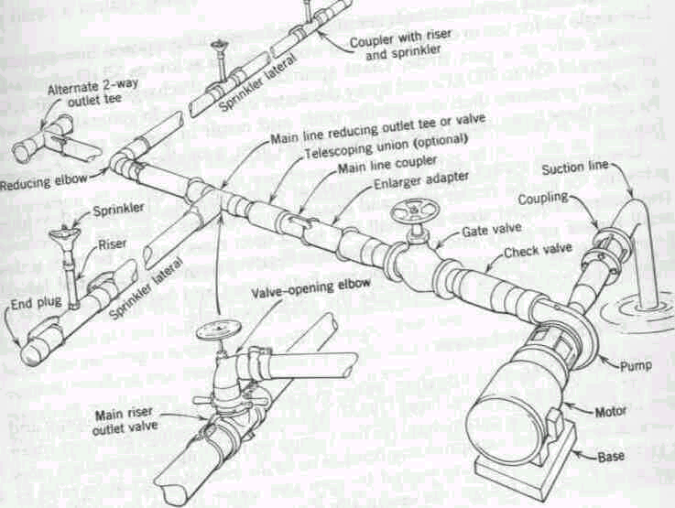
Components of a Sprinkler Irrigation System

Slide 47
3.3.2 Types of Conventional Sprinkler Systems
a) Fully portable system: The laterals, mains, sub-mains and the pumping plant are all portable.
The system is designed to be moved from one field to another or other pumping sites that are in the same field.
b) Semi-portable system: Water source and pumping plant are fixed in locations.
Other components can be moved.
The system cannot be moved from field to field or from farm to farm except when more than one fixed pumping plant is used.

Slide 48
Types of Conventional Sprinkler Systems Contd.
c) Fully permanent system: Permanent laterals, mains, sub-mains as well as fixed pumping plant.
Sometimes laterals and mainlines may be buried.
The sprinkler may be permanently located or moved along the lateral.
It can be used on permanent irrigation fields and for relatively high value crops e.g. Orchards and vineyards.
Labour savings throughout the life of the system may later offset high installation cost.

Slide 49
3.3.3 Mobile Sprinkler Types
a) Raingun: A mobile machine with a big sprinkler.
The speed of the machine determines the application rate. The sprinkler has a powerful jet system.
b) Lateral Move: A mobile long boom with many sprinklers attached to them.
As the machine moves, it collects water from a canal into the sprinklers connected to the long boom.

Slide 50
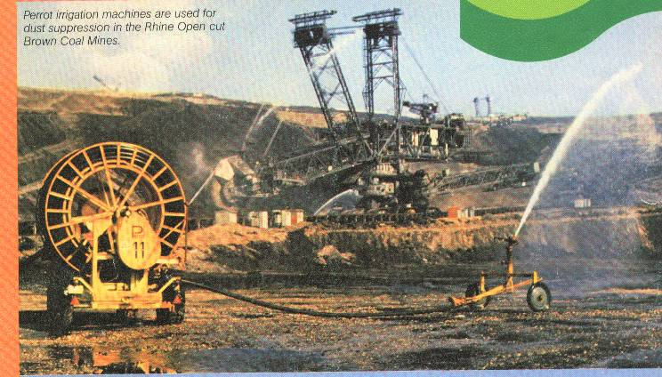
Raingun Irrigation System

Slide 51
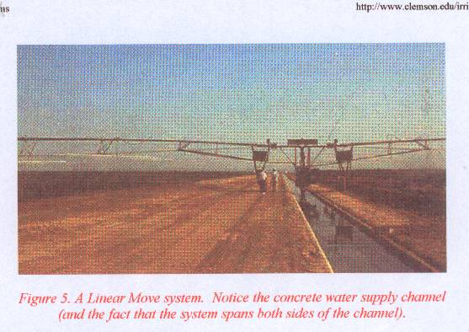
Linear Move

Slide 52
Centre Pivot
c) Centre Pivot: The source of water is stationary e.g. a bore hole. The boom with many sprinklers rotates about the water source.

Slide 53
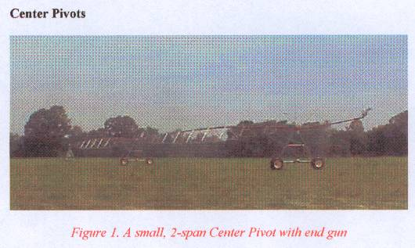
Centre Pivot

Slide 54
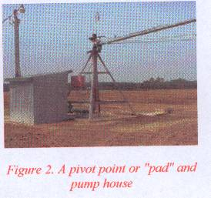
Pivot of a Centre Pivot System

Slide 55
3.3.4 Design of Sprinkler Irrigation System
Objectives and Procedures
Provide Sufficient Flow Capacity to meet the Irrigation Demand
Ensure that the Least Irrigated Plant receives adequate Water
Ensure Uniform Distribution of Water.

Slide 56
Design Steps
Determine Irrigation Water Requirements and Irrigation Schedule
Determine Type and Spacing of Sprinklers
Prepare Layout of Mainline, Submains and Laterals
Design Pipework and select Valves and Fittings
Determine Pumping Requirements.

Slide 57
Choice of Sprinkler System
Consider:
Application rate or precipitation rate
Uniformity of Application: Use UC
Drop Size Distribution and
Cost

Slide 58
Sprinkler Application Rate
Must be Less than Intake Rates
Soil Texture | Max. Appln. Rates (mm/hr.)
Coarse Sand | 20 to 40
Fine Sand | 12 to 25
Sandy Loam | 12
Silt Loam | 10
Clay Loam/Clay | 5 to 8

Slide 59
Effects of Wind
In case of Wind:
Reduce the spacing between Sprinklers: See table 6 in Text.
Allign Sprinkler Laterals across prevailing wind directions
Build Extra Capacity
Select Rotary Sprinklers with a low trajectory angle.

Slide 60
System Layout
Layout is determined by the Physical Features of the Site e.g. Field Shape and Size, Obstacles, and topography and the type of Equipment chosen.
Where there are several possibilities of preparing the layout, a cost criteria can be applied to the alternatives.
Laterals should be as long as site dimensions, pressure and pipe diameter restrictions will allow.
Laterals of 75 mm to 100 mm diameter can easily be moved.
Etc. - See text for other considerations

Slide 61
Pipework Design
This involves the Selection of Pipe Sizes to ensure that adequate water can be distributed as uniformly as possible throughout the system
Pressure variations in the system are kept as low as possible as any changes in pressure may affect the discharge at the sprinklers

Slide 62
Design of Laterals
Laterals supply water to the Sprinklers
Pipe Sizes are chosen to minimize the pressure variations along the Lateral, due to Friction and Elevation Changes.
Select a Pipe Size which limits the total pressure change to 20% of the design operating pressure of the Sprinkler.
This limits overall variations in Sprinkler Discharge to 10%.

Slide 63
Lateral Discharge
The Discharge (Q_{L}) in a Lateral is defined as the flow at the head of the lateral where water is taken from the mainline or submain.
Thus: Q_{L} = N. q_{L} Where N is the number of sprinklers on the lateral and q_{L} is the Sprinkler discharge (m³/h)

Slide 64
Selecting Lateral Pipe Sizes
Friction Loss in a Lateral is less than that in a Pipeline where all the flow passes through the entire pipe Length because flow changes at every sprinkler along the Line.
First Compute the Friction Loss in the Pipe assuming no Sprinklers using a Friction Formula or Charts and then:
Apply a Factor, F based on the number of Sprinklers on the Lateral (See Text for F Values)

Slide 65
Selecting Lateral Pipe Sizes Contd.
Lateral Pipe Size can be determined as follows:
Calculate 20% of Sprinkler Operating Pressure (Pa)
Divide Value by F for the number of Sprinklers to obtain Allowable Pressure Loss (P_{f})
Use Normal Pipeline Head Loss Charts of Friction Formulae with Calculated P_{f} and Q_{L} to determine Pipe Diameter, D.

Slide 66
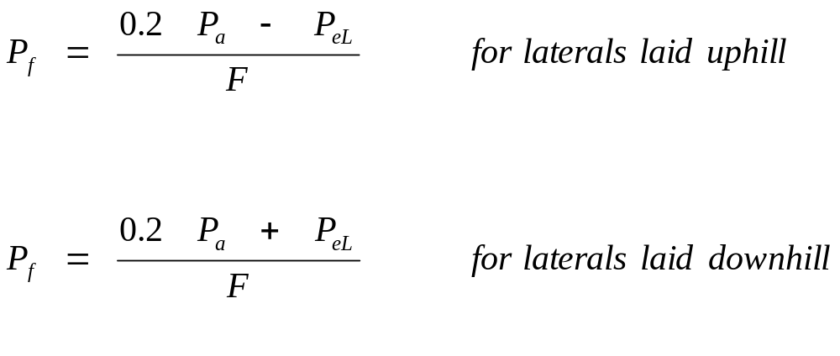
Changes in Ground Elevation
Allowance must be made for Pressure changes along the Lateral when it is uphill, downhill or over undulating land.
If Pe₁ is the Pressure Difference Due to Elevation changes:

Slide 67

Pressure at Head of Lateral
The Pressure requirements (P_{L})where the Lateral joins the Mainline or Submain are determined as follows:
P_{L} = Pa + 0.75 P_{f} + Pr For laterals laid on Flat land
P_{L} = Pa + 0.75 (P_{f} Pe) + Pr For Laterals on gradient.
The factor 0.75 is to provide for average operating pressure (Pa) at the centre of the Lateral rather than at the distal end. Pr is the height of the riser.

Slide 68
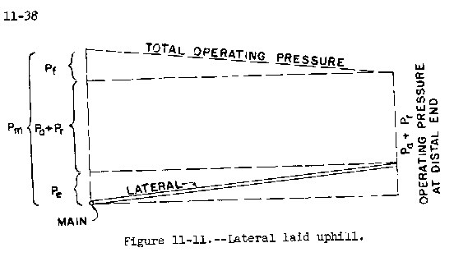
Diagram of Pressure at Head of Lateral

Slide 69
Selecting Pipe Sizes of Submains and MainLines
As a general rule, for pumped systems, the Maximum Pressure Loss in both Mainlines and Submains should not exceed 30% of the total pumping head required.
This is reasonable starting point for the preliminary design.
Allowance should be made for pressure changes in the mainline and submain when they are uphill, downhill or undulating.

Slide 70
Pumping Requirements
Maximum Discharge (Qp) = qs N Where:
qs is the Sprinkler Discharge and
N is the total number of Sprinklers operating at one time during irrigation cycle.
The Maximum Pressure to operate the system (Total Dynamic Head, Pp) is given as shown in Example.

Slide 71
3.4 DRIP OR TRICKLE IRRIGATION
3.4.1 Introduction: In this irrigation system:
i) Water is applied directly to the crop ie. entire field is not wetted.
ii) Water is conserved
(iii) Weeds are controlled because only the places getting water can grow weeds.
(iv) There is a low pressure system.
(v) There is a slow rate of water application somewhat matching the consumptive use. Application rate can be as low as 1 - 12 l/hr.
(vi) There is reduced evaporation, only potential transpiration is considered.
vii) There is no need for a drainage system.

Slide 72
Components of a Drip Irrigation System
Control
Head
Unit
Wetting Pattern
Mainline
Or Manifold
Emitter
Lateral

Slide 73
Drip Irrigation System
The Major Components of a Drip Irrigation System include:
a) Head unit which contains filters to remove debris that may block emitters; fertilizer tank; water meter; and pressure regulator.
b) Mainline, Laterals, and Emitters which can be easily blocked.

Slide 74
3.4.2 Water Use for Trickle Irrigation System
The design of drip system is similar to that of the sprinkler system except that the spacing of emitters is much less than that of sprinklers and that water must be filtered and treated to prevent blockage of emitters.
Another major difference is that not all areas are irrigated.
In design, the water use rate or the area irrigated may be decreased to account for this reduced area.

Slide 75
Water Use for Trickle Irrigation System Contd.
Karmeli and Keller (1975) suggested the
following water use rate for trickle irrigation design
ET_{t} = ET x P/85
Where: ET_{t} is average evapotranspiration rate for crops under trickle irrigation;
P is the percentage of the total area shaded by crops;
ET is the conventional evapotranspiration rate for the crop. E.g. If a mature orchard shades 70% of the area and the conventional ET is 7 mm/day, the trickle irrigation design rate is:
7/1 x 70/85 = 5.8 mm/day
OR use potential transpiration, T_{p} = 0.7 E_{pan} where E_{pan} is the evaporation from the United States Class A pan.

Slide 76
Emitters
Consist of fixed type and variable size types. The fixed size emitters do not have a mechanism to compensate for the friction induced pressure drop along the lateral while the variable size types have it.
Emitter discharge may be described by:
q = K h ^{x}
Where: q is the emitter discharge; K is constant for each emitter ; h is pressure head at which the emitter operates and x is the exponent characterized by the flow regime.

Slide 77
Emitters Contd.
The exponent, x can be determined by measuring the slope of the log-log plot of head Vs discharge.
With x known, K can be determined using the above equation.
Discharges are normally determined from the manufacturer's charts (see Fig. 3.7 in Note).

Slide 78
3.4.4 Water Distribution from Emitters
Emitter discharge variability is greater than that of sprinkler nozzles because of smaller openings(lower flow) and lower design pressures.
Eu = 1 - (0.8 Cv/ n ^{0.5} )
Where Eu is emitter uniformity; Cv is manufacturer's coefficient of variation(s/x ); n is the number of emitters per plant.
Application efficiency for trickle irrigation is defined as:
E_{ea} = Eu x Ea x 100
Where E_{ea} is the trickle irrigation efficiency; Ea is the application efficiency as defined earlier.

Slide 79
3.4.5 Trickle System Design
The diameter of the lateral should be selected so that the difference in discharge between emitters operating simultaneously will not exceed 10 %.
This allowable variation is same as for sprinkler irrigation laterals already discussed.
To stay within this 10 % variation in flow, the head difference between emitters should not exceed 10 to 15 % of the average operating head for long-path or 20 % for turbulent flow emitters.

Slide 80
Trickle System Design Contd.
The maximum difference in pressure is the head loss between the control point at the inlet and the pressure at the emitter farthest from the inlet.
The inlet is usually at the manifold where the pressure is regulated.
The manifold is a line to which the trickle laterals are connected.

Slide 81
Trickle System Design Contd.
For minimum cost, on a level area 55 % of the allowable head loss should be allocated to the lateral and 45 % to the manifold.
The Friction Loss for Mains and Sub-mains can be computed from Darcy-Weisbach equation for smooth pipes in trickle systems when combined with the Blasius equation for friction factor.
The equation is:
H_{f} = K L Q ^{1.75} D ^{– 4.75}
Where: H_{f} is the friction loss in m;
K is constant = 7.89 x 10⁵ for S.I. units for water at 20 ° C;
L is the pipe length in m;
Q is the total pipe flow in l/s; and
D is the internal diameter of pipe in mm.

Slide 82
Trickle System Design Contd
As with sprinkler design, F should be used to compute head loss for laterals and manifolds with multiple outlets, by multiplying a suitable F factor
(See Table 8 of Sprinkler Design section) by head loss.
F values shown below can also be used.

Slide 83
Table 3.7: Correction Factor, F for Friction Losses in Aluminium Pipes with Multiple Outlets.
Number of Outlets F*
1 1.00
2 0.51
4 0.41
6 0.38
8 0.37
12 0.36
16 0.36
20 0.35
30 or more 0.35
*Values adapted from Jensen and Frantini (1957

Slide 84
Example
Design a Trickle Irrigation System for a fully matured orchard with the layout below. Assume that the field is level, maximum time for irrigation is 12 hours per day, allowable pressure variation in the emitters is 15%, the maximum suction lift at the well is 20 m, the ET rate is 7 mm/day and the matured orchard shades 70% of the area; trickle irrigation efficiency is 80%. Sections 1 and 2 are to be irrigated at the same time and alternated with sections 3 and 4. Each tree is to be supplied by 4 emitters.

Slide 85
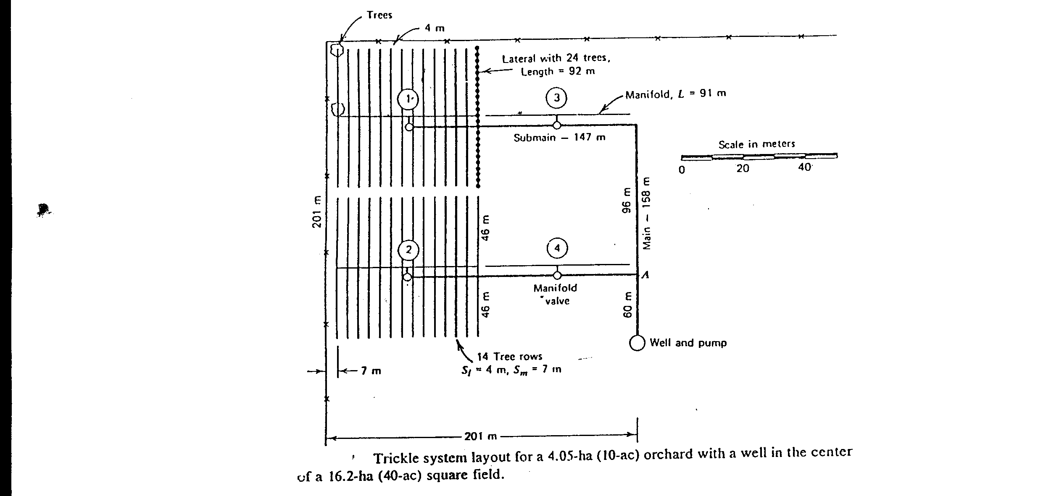
LAYOUT OF THE TRICKLE IRRIGATION SYSTEM

Slide 86
Solution
(1) ETt = ET x P/85
Where: Ett is the average ET for crops under trickle irrigation (mm/day)
ET is nomal ET rate for the crop = 7 mm/day
P is the percentage of total ares shaded by the crop = 70%
ETt = 7 mm/day x 70/85 = 5.8 mm/day.

Slide 87
Solution Contd.
(2) Discharge for each tree with a spacing of 4 m x 7 m
= 4 m x 7 m x 5.8 x 10⁻³ m/day = 0.162 m³/day
= 0.00675 m³/hr (24 hr. day)
For 12 hours of opearation per day, discharge required
= 0.00675 x 24/12 = 0.0135 m³/hr = 0.00375 L/s
With an appliance efficiency of 80%, the required discharge per tree is: 0.00375/0.8 = 0.0047 L/s
The discharge per emitter, with 4 emitters per tree is then:
= 0.0047/4 = 0.00118 L/s = 0.0012 L/s

Slide 88
Discharge of Each Line
Line | No. of Trees | No. of Emitters | Required Discharge (L/s)
Half Lateral | 12 | 48 | 0.0576
Half Manifold | 168 | 672 | 0.8060
Submain, A to Section 1 | 336 | 1344 | 1.6130
Main, A to Pump | 672 | 2688 | 3.2260

Slide 89
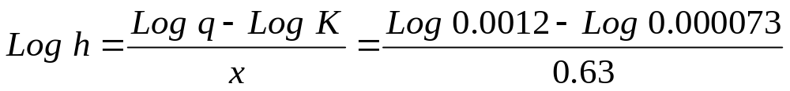
Solution Contd.
(4) From Fig. 21.6 (Soil and Water Conservation), select the medium long-path emitter with K = 0.000073 and x = 0.63
Substituting in equation q = K h^{x}, with an average discharge of 0.0012 L/s,
Log q = log K + x log h
h = 87 kPa or 8.9 m ( or use Chart to obtain h). This is the
Average operating head, Ha.

Slide 90
Solution Contd.
(5) Total allowable pressure loss of 15 % of Ha in both the Lateral and Manifold = 8.9 x 0.15 =1.3 m of which 0.55 x 1.3 = 0.7 m is allowed for Lateral and 0.45 x 1.3 = 0.6 is for the Manifold.
(6) Compute the Friction Loss in each of the Lines from Equation:
H_{f} = K L Q ^{1.75} D ^{–4.75} by selecting a diameter to keep the loss within the allowable limits of 0.7 m and 0.6 m, already determined.

Slide 91
Selection of Diameters
Line | Q (L/s) | Pipe Diameter (mm) | L (m) | F | H_{f}’ (m)
Half Lateral | 0.0576 | 12.70 | 46 | 0.36 | 0.51
Half Manifold | 0.8060 | 31.75 | 45.5 | 0.36 | 0.68
Sub-Main, A to Section 1 | 1.6130 | 44.45 | 243 | 1 | 6.59
Main, A to Pump | 3.2260 | 50.80 | 60 | 1 | 2.90

Slide 92
Pressure Head at Manifold Inlet
Like Sprinklers, the pressure head at inlet to the manifold:
= Average Operating Head = 8.9 m
+ 75% of Lateral and Manifold head Loss = 0.75 (0.51 + 0.68)
+ Riser Height = Zero for Trickle since no risers exist.
+ Elevation difference = Zero , since the field is Level
= 9.79 m

Slide 93
Solution Concluded
Total Head for Pump
= Manifold Pressure = 9.79 m
+ Pressure loss at Sub-main = 6.59 m
+ Pressure loss at Main = 2.90 m
+ Suction Lift = 20 m
+ Net Positive Suction head for pump = 4 m (assumed)
= 43.28 m
i.e. The Pump must deliver 3.23 L/s at a head of about 43 m.

Slide 94
3.5 SUB-SURFACE IRRIGATION
Applied in places where natural soil and topographic condition favour water application to the soil under the surface, a practice called sub-surface irrigation. These conditions include:
a) Impervious layer at 15 cm depth or more
b) Pervious soil underlying the restricting layer.
c) Uniform topographic condition
d) Moderate slopes.

Slide 95
SUB-SURFACE IRRIGATION Contd.
The operation of the system involves a huge reservoir of water and level is controlled by inflow and outflow.
The inflow is water application and rainfall while the outflow is evapotranspiration and deep percolation.
It does not disturb normal farm operations. Excess water can be removed by pumping.

Slide 96
3.6 CHOICE OF IRRIGATION METHODS:
The following criteria should be considered:
(a) Water supply available
(b) Topography of area to be irrigated
c) Climate of the area
(d) Soils of the area
(e) Crops to be grown
f) Economics
(g) Local traditions and skills
(For details see extract from Hudson's Field Engineering).

Slide 97
3.7 INFORMATION TO BE COLLECTED ON A VISIT TO A PROPOSED IRRIGATION SITE.
a) Soil Properties: Texture and structure, moisture equilibrium points, water holding capacity, agricultural potential, land classification, kinds of crops that the soil can support.
b) Water Source: Water source availability eg. surface water, boreholes etc., hydrologic data of the area, water quantity, water quality, eg. sodium adsorption ratio, salt content, boron etc.; possible engineering works necessary to obtain water.
c) Weather data: Temperature, relative humidity, sunshine hours and rainfall.

Slide 98
INFORMATION TO BE COLLECTED
d) Topography e.g. slope: This helps to determine the layout of the irrigation system and method of irrigation water application suited for the area.
e) History of People and Irrigation in the area: Check past exposure of people to irrigation and land tenure and level of possible re-settlement or otherwise.
f) Information about crops grown in the area: Check preference by people, market potential, adaptability to area, water demand, growth schedules and planting periods.

