Slide 1

ZİRAAT FAKÜLTESİ
Tarımsal Yapılar ve Sulama Bölümü
TYS-624 Yüzey Sulama Sistemlerinin Planlanması
Doç. Dr. Kadir Ersin TEMİZEL

Slide 2

Karık sulama yönteminde sulama randımanını artırma
TYS-624 Yüzey Sulama Sistemlerinin Planlanması
Hafta-9

Slide 3
3.2.1 Furrow Irrigation
In furrow irrigation, only a part of the land surface (the furrow) is wetted thus minimizing evaporation loss.
Furrow irrigation is adapted for row crops like corn, banana, tobacco, and cabbage. It is also good for grains.
Irrigation can be by corrugation using small irrigation streams.
Furrow irrigation is adapted for irrigating on various slopes except on steep ones because of erosion and bank overflow.

Slide 4
Furrow Irrigation Contd.
There are different ways of applying water to the furrow.
As shown in Fig. 3.1, siphons are used to divert water from the head ditch to the furrows.
There can also be direct gravity flow whereby water is delivered from the head ditch to the furrows by cutting the ridge or levee separating the head ditch and the furrows (see diagram from Gumb's book).
Gated pipes can also be used. Large portable pipe(up to 450 mm) with gate openings spaced to deliver water to the furrows are used.
Water is pumped from the water source in closed conduits.
The openings of the gated pipe can be regulated to control the discharge rate into the furrows.

Slide 5
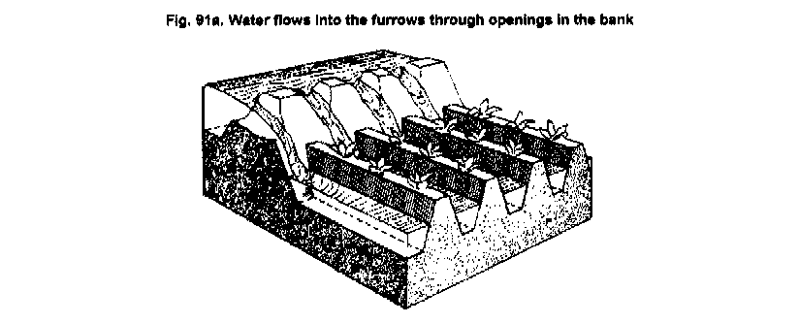
Furrow Irrigation by Cutting the Ridge

Slide 6
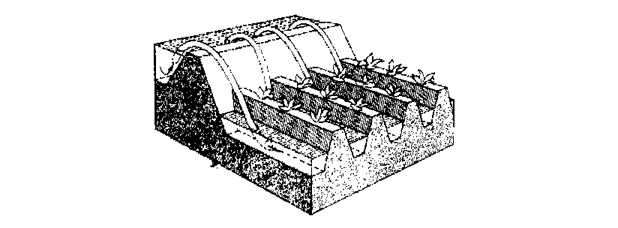
Furrow Irrigation with Siphons

Slide 7
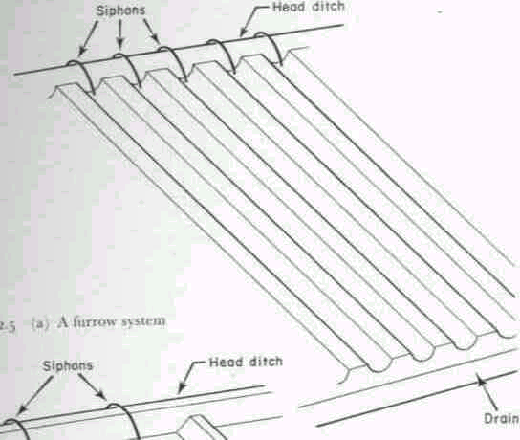
Fig. 3.1: A Furrow System

Slide 8
3.2.1.1 Design Parameters of Furrow Irrigation
The Major Design Considerations in Surface Irrigation Include:
Storing the Readily Available Moisture in the Root Zone, if Possible;
Obtaining As Uniform Water Application As Possible;
Minimizing Soil Erosion by Applying Non-erosive Streams;
Minimizing Runoff at the End of the Furrow by Using a Re-use System or a Cut -Back Stream;
Minimizing Labour Requirements by Having Good Land Preparation,
Good Design and Experienced Labour and
Facilitating Use of Machinery for Land Preparation, Cultivation, Furrowing, Harvesting Etc.

Slide 9
Furrow Irrigation Contd.
The Specific Design Parameters of Furrow Irrigation Are Aimed at Achieving the Above Objectives and Include:
a) Shape and Spacing of Furrows: Heights of ridges vary between 15 cm and 40 cm and the distance between the ridges should be based on the optimum crop spacing modified, if necessary to obtain adequate lateral wetting, and to accommodate the track of mechanical equipment.
The range of spacing commonly used is from 0.3 to 1.8 m with 1.0 m as the average.

Slide 10
Design Parameters of Furrow Irrigation Contd.
b) Selection of the Advance or Initial Furrow Stream: In permeable soils, the maximum non-erosive flow within the furrow capacity can be used so as to enable wetting of the end of the furrow to begin as soon as possible.
The maximum non-erosive flow (Q_{m}) is given by: Q_{m} = c/S where c is a constant = 0.6 when Q_{m} is in l/s and S is slope in %.
Example 1: For a soil slope of 0.1 %, the Q_{m} is 0.6/0.1 = 6 l/s.

Slide 11
Design Parameters of Furrow Irrigation Contd.
The actual stream size should be determined by field tests.
It is desirable that this initial stream size reaches the end of the furrow in T/4 time where T is the total time required to apply the required irrigation depth.
c) Cut-back Stream: This is the stream size to which the initial stream is reduced sometime after it has reached the lower end of the field.
This is to reduce soil erosion.
One or two cutbacks can be carried out and removing some siphons or reducing the size at the head of the furrow achieves this.

Slide 12
Design Parameters of Furrow Irrigation Contd.
d) Field Slope: To reduce costs of land grading, longitudinal and cross slopes should be adapted to the natural topography.
Small cross slopes can be tolerated.
To reduce erosion problems during rainfall, furrows (which channel the runoff) should have a limited slope (see Table 3.1).

Slide 13
Table 3.1 : Maximum Slopes for Various Soil Types
Soil Type Maximum slopes*
Sand 0.25
Sandy loam 0.40
Fine sandy loam 0.50
Clay 2.50
Loam 6.25 Source: Withers & Vipond (1974)
*A minimum slope of about 0.05 % is required to ensure surface drainage.

Slide 14
Design Parameters of Furrow Irrigation Contd.
e) Furrow Length: Very long lengths lead to a lot of deep percolation involving over-irrigation at the upper end of the furrow and under-irrigation at the lower end.
Typical values are given in Table 3.2, but actual furrow lengths should be got from field tests.

Slide 15
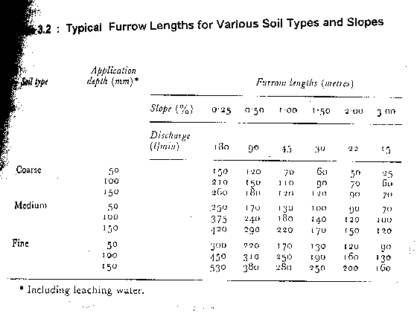

Slide 17
Design Parameters of Furrow Irrigation Contd.
e) Field Widths: Widths are flexible but should not be of a size to enclose variable soil types.
The widths should depend on land grading permissible.

Slide 18
3.2.1.2 Evaluation of a Furrow Irrigation System
The objective is to determine fairly accurately how the system is used and to suggest possible amendments or changes.
Equipment: Engineers Level and Staff,
30 m Tape,
Marker Stakes,
Siphons of Various Sizes,
Two Small Measuring Flumes,
Watch with Second Hand and Spade.

Slide 19
Evaluation of a Furrow Irrigation System Contd.
Procedure
a) Select several (say 3 or more) uniform test furrows which should be typical of those in the area.
b) Measure the average furrow spacing and note the shape, condition etc.
c) Set the marker stakes at 30 m intervals down the furrows.
d) Take levels at each stake and determine the average slope.
e) Set the flumes say 30 m apart at the head of the middle furrow.
f) Pass constant flow streams down the furrows, using wide range of flows. The largest flow should just cause erosion and overtopping, the smallest might just reach the end of the furrow. The median stream should have a discharge of about Q = 3/4 S (l/s) where S is the % slope.

Slide 20
Evaluation of a Furrow Irrigation System Contd.
g) Record the time when flow starts and passes each marker in each flow(advance data).
h) Record the flow at each flume periodically until the flows become practically constant. This may take several hours on fine textured soils(Infiltration data).
i) Check for evidence of erosion or overtopping.
j) Move the flumes and measure the streams at the heads only of the other furrows.
Results: To be presented in a format shown:
............................................................................................................
Watch Opportunity time(mins)
Station A Station B Losses
Time A B C Depth Flow Depth Flow Diff Infil.
(mm) ( L/s) (mm) (L/s) (L/s) (mm/h)
..............................................................................................................
Notes:
Solve problem in note.

