Slide 1
Sosyal Antropoloji
1. Antropoloji Nedir? Antropologlar Ne Yapar?

Slide 2
Etimoloji
Antropoloji
Anthropology (İng. İnsanlar hakkındaki bilim)
anthropo ← anthropos (Yun. insan)
+
logy (bilim) ← logos (Yun. akıl)

Slide 3
Antropolojinin İlgi Alanı
Bütün bir insan topluluğu
Varoluşumuzun çeşitli yönleri arasındaki bağlantıları anlamaya çalışmak - bütüncül yaklaşım
Notes:
The field of interest: the whole of human society
Tries to understand the connections between the various aspects of our existence

Slide 4
Antropoloji ve Alt Alanları
Fiziksel antropoloji
    İnsanın evrimi ve çevresine uyum sağlama meselesini inceleyen bilim dalı
    – paleoantropoloji (insan türünün kökenlerini ve öncüllerini inceleyen bilim dalı)
    – möleküler antropoloji (insan evrimiyle ilgili hipotezleri sınama amacıyla genetik ve biyokimyasal teknikler kullanan bir fiziksel antropoloji dalı)
Dilbilimsel antropoloji
    Dilin betimlenmesiyle (cümlenin nasıl kurulduğu) ya da dillerin tarihçesiyle (dillerin zaman içinde nasıl gelişip değiştiği) kültür arasındaki ilişkiyi inceleyen bilim dalı.
Kültürel antropoloji
    İnsan davranışı, düşüncesi ve duygularındaki geleneksel kalıplarını inceleyen Kuzey Amerika’da hakim olan bilim dalı.
Sosyal antropoloji
    Aile ve akrabalık, siyaset ve ekonomi, din ve kanun gibi toplumsal sistemlerinin toplumlar arası çeşitliği ve benzerliği inceleyen Britanya’da hakim olan bilim dalı
Notes:
‘Irk bilimi’?? Bkz. Nazan Maksudyan 2005 ‘Irkçı Bir “Bilimsel” Disiplin Olarak Antropolojinin Tarihi’. ss.15-29. … Frenoloji (Kafatası Bilimi) s.25
In contrast to cultural anthropology, culture and its continuity (including narratives, rituals, and symbolic behavior associated with them) have been traditionally seen more as the dependent "variable" by social anthropology, embedded in its historical and social context, including its diversity of positions and perspectives, ambiguities, conflicts, and contradictions of social life, rather than the independent (explanatory) one.

Slide 5
Kültürel Çeşitlilik ve İnsan Tabiatı
Antropoloji, insanların ne kadar farklılık gösterebilecekleri hakkındadır (özelci yaklaşım), fakat insanların aynı zamanda hangi ölçüde belirli ortaklıklara sahip olduklarını da (evrenselci yaklaşım) anlamaya çalışır.
Notes:
Anthropology is about how different people can be; in what sense it can be said that all humans have something in common
By a detailed study of local life in a particular society – traditionally small-scale non-industrial society but no longer so …

Slide 6
Sosyal/kültürel antropoloji, sosyal ve kültürel yaşamın karşılaştırmalı olarak incelenmesidir.
Sosyolojiden farklı olarak yalnız sanayileşmiş toplumu incelemez;
Felsefeden farklı olarak deneysel araştırmayı önemsel;
Tarihten farklı olarak toplumları yaşadıkları esnada inceler.

Slide 7
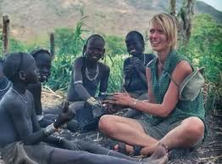
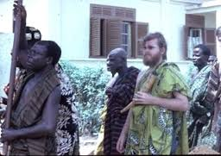
Sosyal/Kültürel Antropolojinin
Araştırma Yöntemleri
Uzun süreli alan çalışması
Katılımcı gözlem
Toplumu içerden anlamaya çalışılması
Notes:
Basically, cultural and social anthropology is the comparative study of culture and social life. Its most important method is p.o. which consists of lengthy fieldwork in a particular social setting. Through participant observation, anthropologists try to understand a society from inside.
In order to understand ‘cultural diversity and human nature’, anthropologists conduct a detailed study of local life in a particular society – traditionally small-scale non-industrial society yet no longer so … In other words, anthropologists ask big questions about human nature from small places. Studying a remote foreign society, which most anthropologists do, help seeing apparently trivial, routine, daily things anew and revealing something about human nature.
1. In anthropology, fieldwork is the most important source of new knowledge. Anthropological fieldwork takes live among locals in a long term, long enough for one’s existence to be taken almost “natural” and enough to be able to see the world as the locals see it, though it may be impossible in an ultimate sense.
2. In participant observation, an anthropologist immerses oneself into the life of the locals and tries not to be noticed in order to enter as deeply as possible into the social life one researches. Hiding one’s own identity or hidden observation might seem effective, yet it is unethical, that is, an unacceptable form of research. Thus, anthropological fieldwork is not capital intensive but labour and time intensive. The anthropologist herself is the most important “instrument” of data collection; she invests a great deal of her own time and personality.
3. Many anthropologists involuntarily take on the role of the clown when in the field. But, the locals’ reaction gives an idea about their way of thinking. A more problematic role of the anthropologist in the field can be the expert role. She tends to be treated formally and hence may access only the elite or only men and not be able to see some aspects of a society.

Slide 8
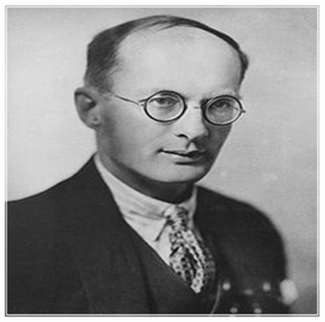
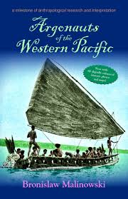
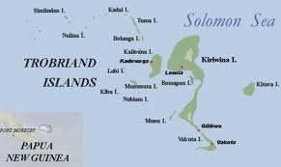
Katılımcı Gözlem
Bronislaw K. Malinowski (1884-1942)
Argonauts of the Western Pacific (Batı Pasifiğin Maceracılar) (1922)

Slide 9
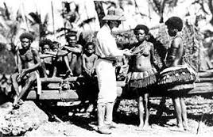
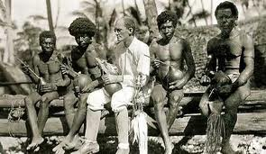
Trobriand Adalılar ile Malinowski
Notes:
The tidy, systematic and well-rounded texts written by anthropologists are the end product of long periods in the field characterized by boredom, illness (unfamiliar climate, strange food, and a different hygienic standard), helplessness (poorly mastered language and code of behaviour) , private privations (never left alone) and frustration. Anthropological fieldwork is a physically and mentally demanding task. Malinowski’s diary (1967) shocked the anthropologists for he’d been thought as a guru of p.o. It means that it is possible to conduct a good fieldwork even if she cannot be a “part” of natives.

Slide 10
Antropolojinin Önemli İlkeleri
Etnosantrizme (Başka toplumları bir toplumun kendine özgü kültürel varsayımlarından yola çıkarak yargılarda bulunması) karşı
“Metodolojik” kültürel görelilik (Doğru, ahlak ve bilginin toplumsal düzlemde kurulduğu ve değişik kültürlere göre farklılaştığını varsayan yaklaşım)
Bütünsel bakış açısı
Kaynak: Khan Akademi Türkçe
Notes:
Etnosentrizm: Etnik merkezcilik, Başka toplumları bir toplumun kendine özgü kültürel varsayımlarından yola çıkarak yargılarda bulunması
Kültürel görelilik: Doğru, ahlak ve bilginin toplumsal düzlemde kurulduğu ve değişik kültürlere göre farklılaştığını varsayan yaklaşım

Slide 11
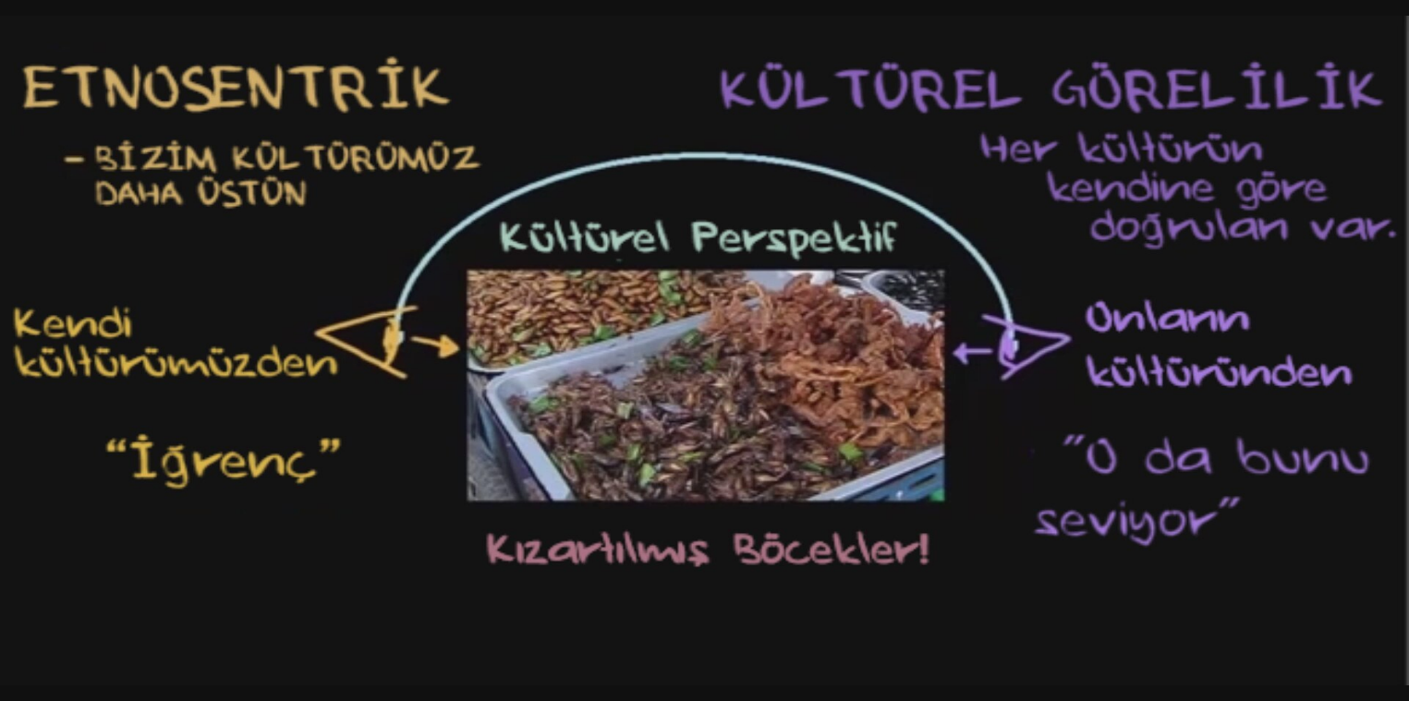
Kaynak: Khan Akademi Türkçe

Slide 12


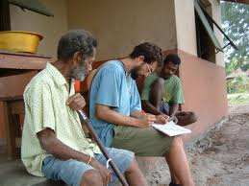
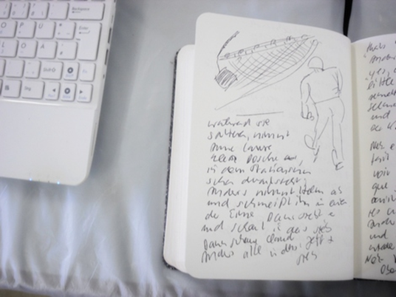

Etnografya
tümdengelim
etnografi
↓
ethnography
ethno (halk) + graphy (graphia=yazmak)
= insanlar hakkında yazmak, yazı
“Teoriden yoksun ampirik çalışma kördür ve ampirik çalışmadan yoksun teori topaldır (Gedanken ohne Begriffe sind blind)” Imannuel Kant 1781
teori
veri
tümevarım
→
Alan çalışması
Saha defteri
etnografya
Notes:
From the classic monograph (a comprehensive overview of the way of life of a people)
To the modern ethnography (a case study of a highly specialized subject) because general knowledge has been accumulated enough in almost all societies of the world; no longer need to start from scratch

Slide 13
Bilimsel Metin olarak Etnografi ve Nesnellik Sorunu
Yorum, analiz ve gerçeklik
Emik ve etik yaklaşımlar (toplumsal aktörün ve araştırmacının analitik bakış açıları)
Antropolojik araştırmanın yerel topluma etkisi
Siyasal araç olarak etnografik bilgiler
Etnografik geniş zaman ve geçmiş zaman …
Notes:
Ethnography is far from neutral and objective description of a people …
Even if the anthropologist aims to reproduce reality the way it is perceived by the informants, there are three reasons why the result may never be an emic description: First, we must usually translate between different languages. Second, we use a written medium to reproduce oral statements. Third, the anthropologist can never become identical with the people he or she writes about. & It is necessary to use abstract terms for comparison.
Is vernacular anthropology a solution? But the point is not whether the “native” or the “scientists” are correct, but rather that social scientists have specialized academic interests … it is scientific research after all, a way to seek an account to a particular question.
Anthropological texts are usually written in the present tense. Many of the influential monographs were nevertheless written half a century ago or more, and in virtually every case the societies they deal with have changes radically since the original fieldwork took place. Moreover, fieldwork was carried out during an unusual historical period of political stability – for instance between the First World War and 1960 in case of African anthropology which has been absent both before and afterwards in large parts of Africa.
Social anthropology has never tried to replace history. It traditionally have focused on social and cultural interrelationships at a particular point in time … Boas, Radcliffe Brown and Malinowski were all critical of the rather speculative forms of cultural history … Most anthropological studies may be describes as “snapshots”. We may use the term “ethnographic present” to characterize the literary tense involved. They contribute to our comparative knowledge of forms of human life.
But the overemphasis of the relative isolation and unchanging character (timelessness) contribute to othering a society far away.

Slide 14
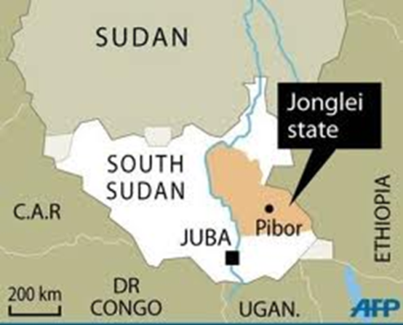
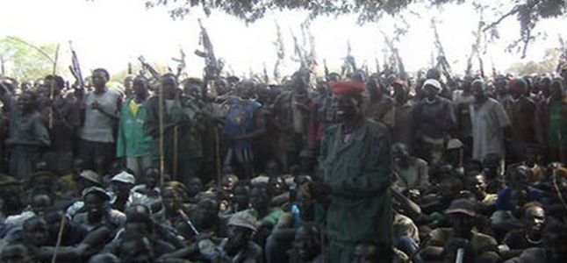

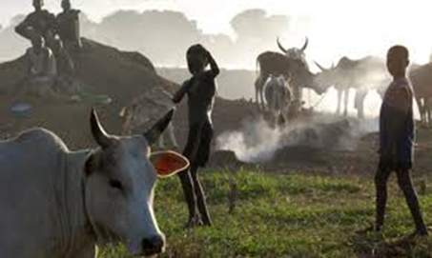
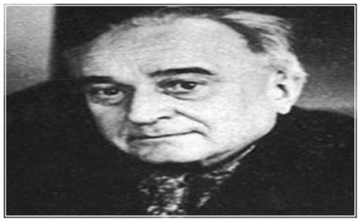
Etnografik geniş zaman ve geçmiş zaman
Nuerler: Güney Sudan’ın bir bölgesinde yaşayan sığır çobanlığı ile geçinen nomadik bir halk. İyi savaşçı olarak bilinir ...
II. Sudan İç Savaşı (1985-2005)
Sudan hükümetine karşı Nuer Beyaz Askerleri
Notes:
The Nuer White Army, sometimes decapitalised as the "white army", is a semi-official name for a militant organisation formed by the Nuer people of central and eastern Greater Upper Nile in modern-day South Sudan as early as 1991. According to the Small Arms Survey, it arose from the 1991 schism within the Sudan People's Liberation Movement/Army (SPLM/A) for the dual purpose of defending Nuer cattle herds from neighbouring groups and fighting in the 1990s Second Sudanese Civil War between the SPLM/A and the Sudanese government. During the Second Sudanese Civil War, White Army fighters mainly from the Lou Nuer subtribe backed the breakaway SPLM/A faction led by Riek Machar, known as SPLA-Nasir, in attacks on the Dinka majority. However, the fighters never formed long-term alliances with other factions in the war, acting for short-term benefit only. Among their most regular enemies were the Murle people, a rival tribe competing for land and cattle in the states of Jonglei and Upper Nile. During the war, though the term "White Army" could refer collectively to Nuer youth militants, there was rarely any functioning central authority for the disparate fighters, and a number of White Army factions based around different cattle camps operated autonomously or semi-autonomously of one another. The ranks of leadership had a reportedly high rate of turnover.
2000s
After the Comprehensive Peace Agreement of 2005 between the government of Sudan and the SPLM/A, which formed the Autonomous Government of Southern Sudan, the Nuer White Army lost its remaining coherence. By February 2006, Nuer elders interviewed by Small Arms Survey workers acknowledged they had little or no control over the armed youths and said the incidence of cattle theft and other miscreant behaviour on the youths' part was increasing. Riek Machar, the White Army's erstwhile wartime ally, announced the White Army would be disbanded amidst a SPLM/A disarmament campaign in the region. However, it was not until a major defeat in May 2006 near Motot, in Jonglei's Uror County, in which 113 White Army fighters were reportedly killed for the loss of a single Sudan People's Liberation Army (SPLA) soldier, that the fighters gave up their attempts at resistance, according to the Small Arms Survey. The news service IRIN reported that more than 1,000 Lou Nuer men and boys in Akobo County who had been part of the White Army voluntarily surrendered their weapons to authorities in July 2006.
2010s
In late December 2011, several months after South Sudan gained its independence, The Upper Nile Times reported that the Nuer White Army had reformed and had issued a threat on Christmas Day 2011 to "wipe out the entire Murle Tribe on the face of the earth as the only solution to guarantee long-term security of Nuer's cattle". The statement also declared the White Army's intention to fight the SPLA and the United Nations, which has a peacekeeping mission in the country. The declaration marked an escalation in the ongoing clashes between the SPLA, the Murle, and the Lou Nuer in Jonglei and Upper Nile, which began when armed Murle fighters under the influence of George Athor's South Sudan Democratic Movement launched a cattle raid against the Lou Nuer in Jonglei state. UNMISS responded by deploying peacekeepers to Pibor town and urging both the Murle and Lou Nuer to lay down their arms.

Slide 15
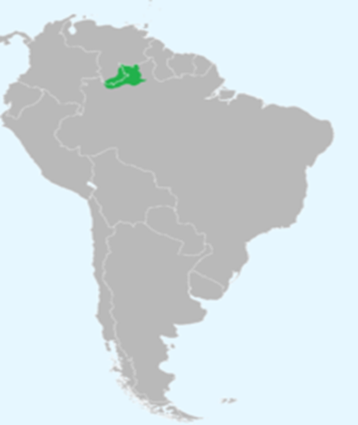
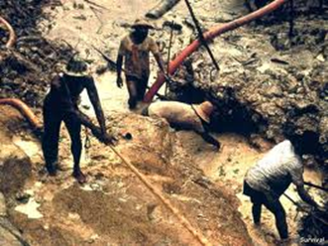
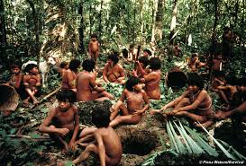
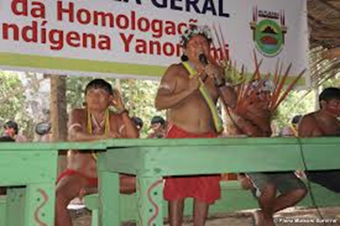
Yanomamöler: Brezilya ve Venezuela sınırında yaşayan yerel halkı ...
Amazon ormanında altın madencileri
Yanomamölerin arazi mülkiyet hakkı için mücadelesi

Slide 16
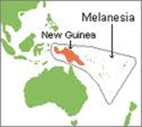
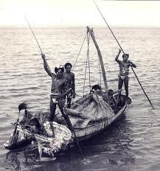

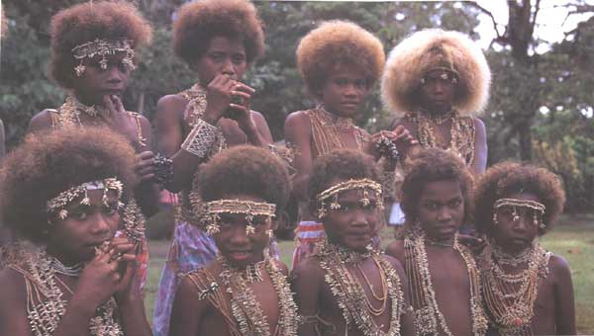
Melanesia halkları: Pasifik Okyanus’un alt bölgesi, Vanuatu, Solomon Adaları, Fiji and Papua Yeni Gine gibi ülkeler var. Bu bölgedeki toplumsal tabakalaşma sistemi ve yerel kültür bir çok antropologlar tarafından incelenmiştir...
Turizm ve Metalaşan Fiji kültürü

Slide 17
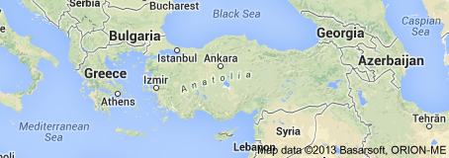
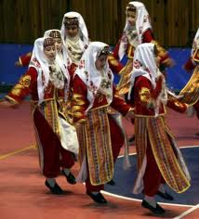

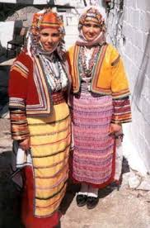
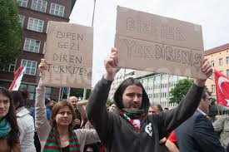
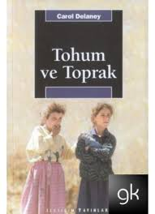
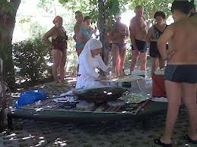
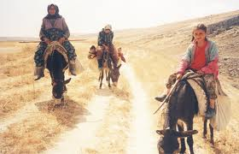
Türkler: çoğunlukla Türkiye ve Osmanlı İmparatorluğu'nun eski topraklarında yaşayan halktır. ...

Slide 18
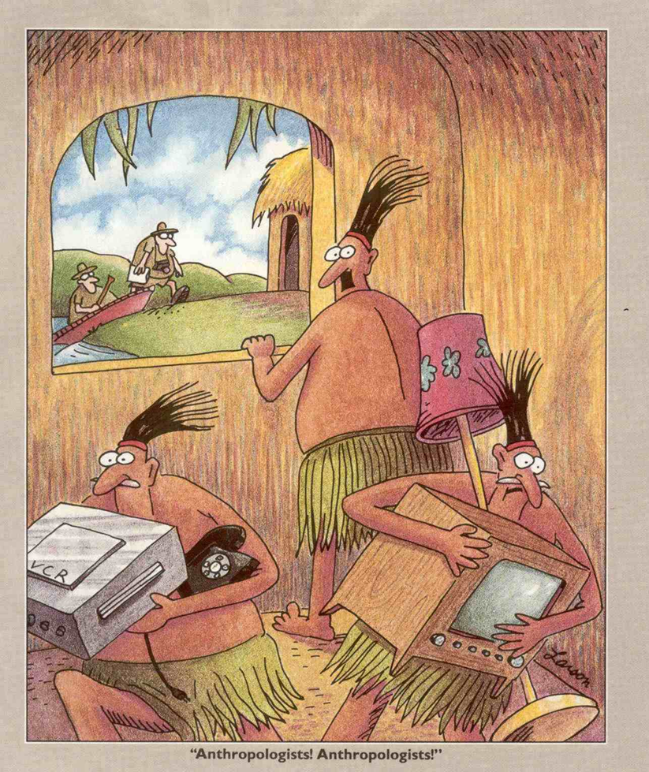
Antropologlar! Antropologlar!

Slide 19
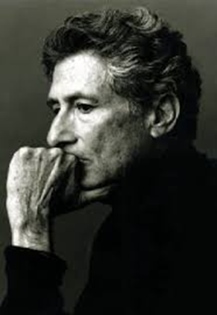
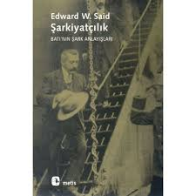
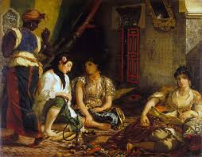
Oryantalizm
Aydınlanma çağı sonrası dönemden itibaren Yakın ve Uzak Doğu toplum ve kültürleri, dilleri ve halklarının incelendiği batı merkezli, özselleştirci, zaman zaman romantik ve dolayısıyla ötekileştirci edebi, sanatsal ve bilimsel çalışmaların tümüne işaret eder.
Edward Said
(1935-2003)
1978
Eugène Delacroix, The Women of Algiers, 1834, the Louvre, Paris

Slide 20
“Modern” toplumun antropolojisi
Gereneksel antropolojik çalışmalarda –sosyolojiden farklı olarak –
katılımcı gözlem ve saha araştırmasını çok önemsiyordu ve
çoğunlukla sanayıleşmemiş toplumlar inceleniyordu.

Slide 21
“Modern” toplumun antropolojisi
Ancak, son zamanlarda “modern” toplumlarda birçok araştırmalar yapılmaktadır çünkü;
modernleşme ve sanayileşmeden etkilenmemiş toplum yok oldu;
“modern” toplumların birbirinden çok farklı olabileceğini anlaşıldı;
kendi ya da yakın toplumda araştırma yapmak daha kolaydır.

