Slide 1
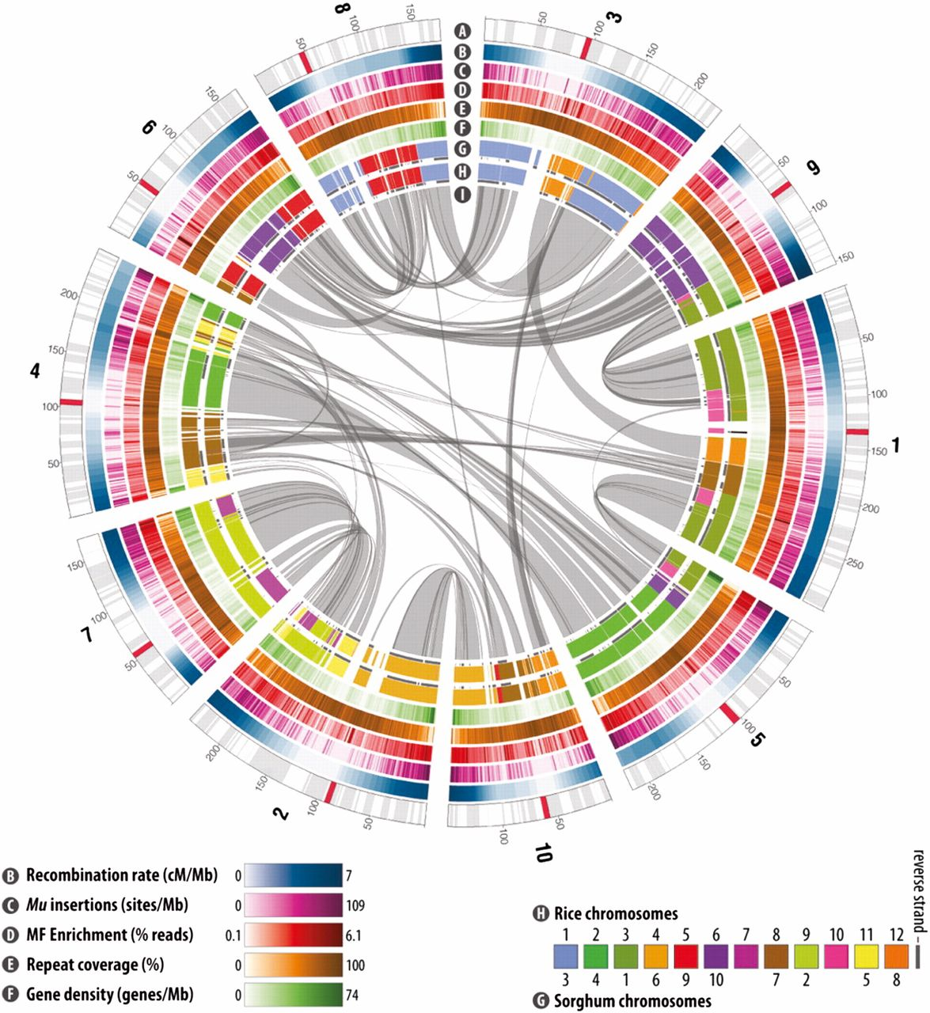
Genome Annotation
Dr. Hilal AY

Slide 2
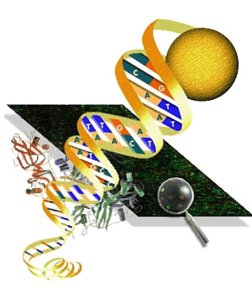
Genome annotation

Slide 3
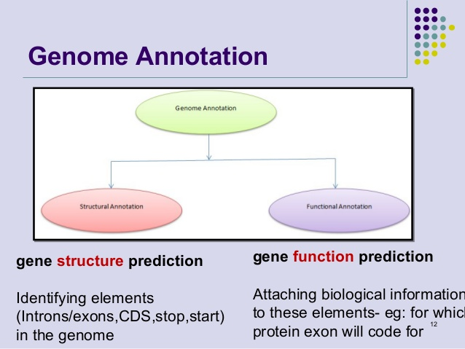
Genome annotation

Slide 4
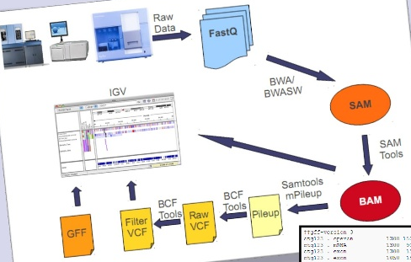
Genome Annotation by Computer Analysis of
DNA Sequence

Slide 5
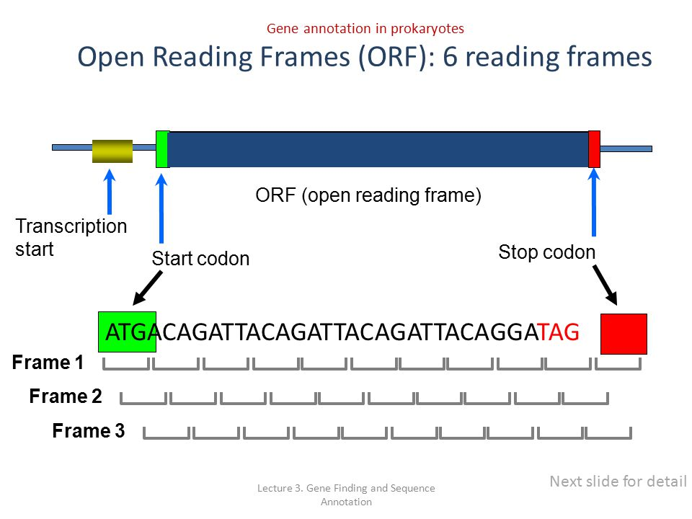
The coding regions of genes are open reading frames

Slide 6
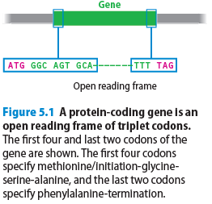
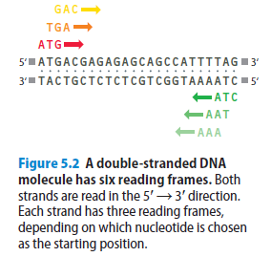
The coding regions of genes are open reading frames

Slide 7
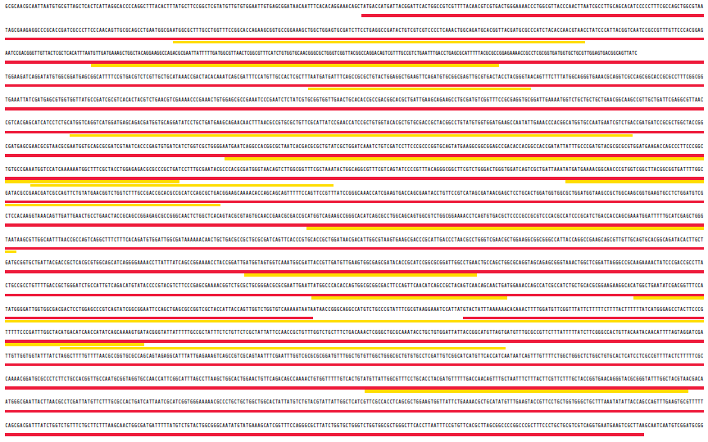
ORF scanning is an effective way of locating genes in a bacterial genome

Slide 8
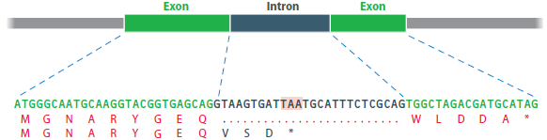
Simple ORF scans are less effective with genomes of higher eukaryotes

Slide 9
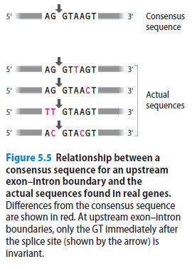
Simple ORF scans are less effective with genomes of higher eukaryotes
Three modifications to the basic procedure for ORF scanning have been adopted.
Codon bias
Exon–intron boundaries
Upstream regulatory sequences

Slide 10
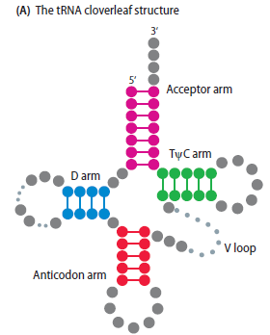
Locating genes for noncoding RNA
The distinctive features of tRNAs aid in location of the genes for these noncoding RNAs. (A) All tRNAs fold into the cloverleaf structure, which is held together by intramolecular base pairing in the four highlighted regions.
(B) The DNA sequence for the gene for one of the Escherichia coli tRNAs specific for the amino acid leucine is shown. Highlighted segments correspond to the regions of intramolecular base pairing shown in part A. The sequence constraints imposed by the need for these segments to be able to base-pair to one another provide features that can be searched for by computer programs designed to locate tRNA genes.

Slide 11
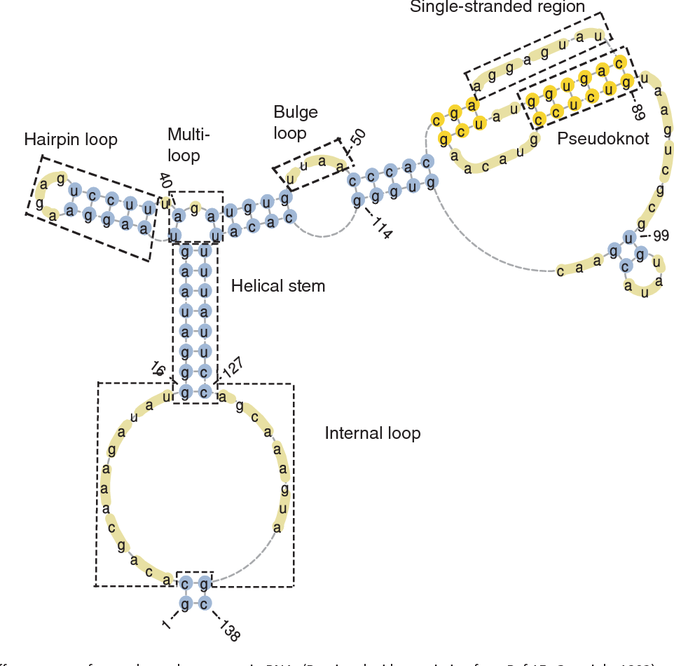
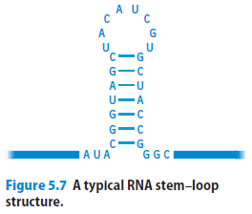
Locating genes for noncoding RNA

Slide 12
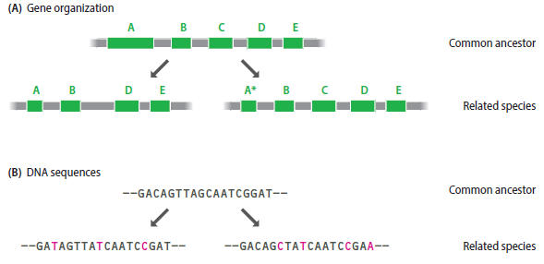
Homology searches and comparative genomics give an extra dimension to gene prediction
Figure 5.8 related species have similar genomes. (A) An illustration of how gene organization might change as two species diverge from their common ancestor. The common ancestor has five genes labeled A–E. In one of the derived species, gene C is no longer present, and in the other species, gene A has become truncated. (B) Related species display DNA sequence similarities. The diagram shows a short section of a gene sequence from an ancestral organism, along with the homologous sequences for this gene segment in the derived species.

Slide 13
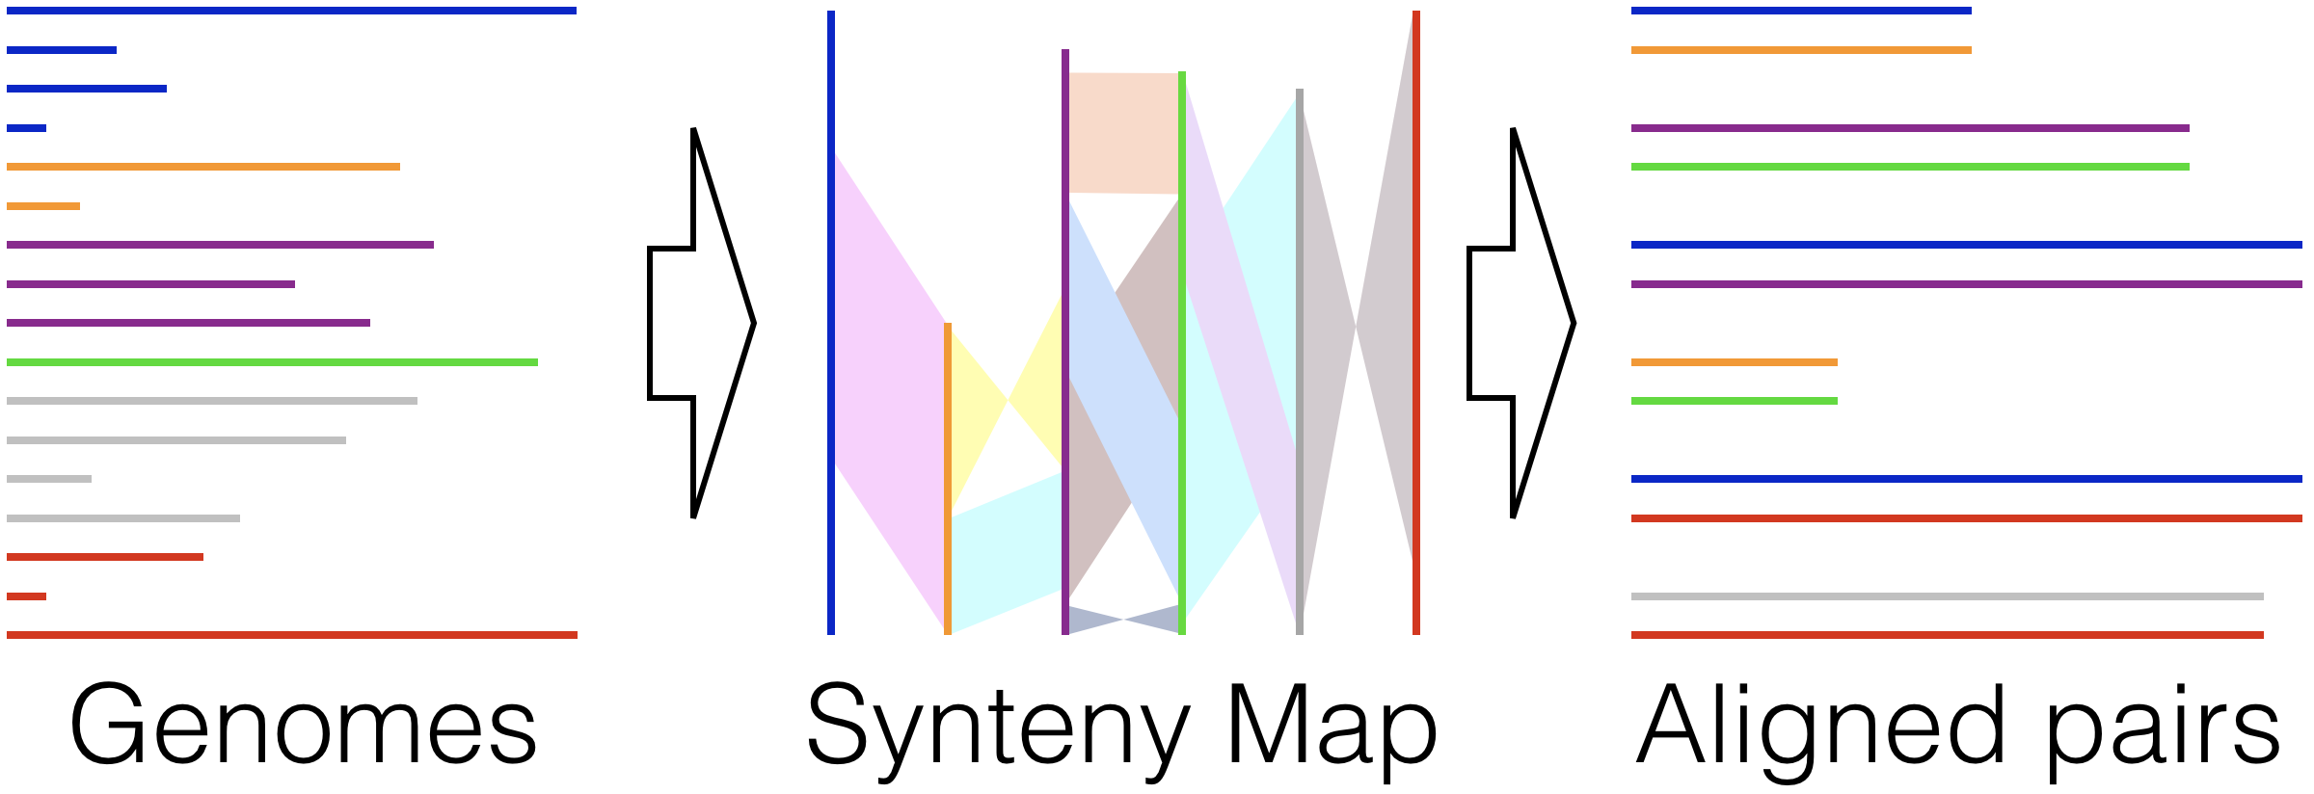
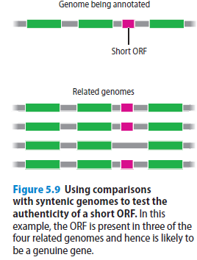
Homology searches and comparative genomics give an extra dimension to gene prediction

Slide 14
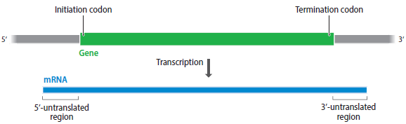
Genome Annotation by Analysis of Gene Transcripts

Slide 15
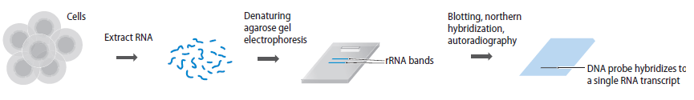
Hybridization tests can determine if a fragment contains transcribed sequences
Figure. Northern hybridization. An RNA extract is electrophoresed under denaturing conditions in an agarose gel. After ethidium bromide staining, two bands are seen. These are the two largest rRNA molecules, which are abundant in most cells. The smaller tRNAs, which are also abundant, are not seen because they are so short that they run out the bottom of the gel, and in most cells, none of the mRNAs is abundant enough to form a band visible after ethidium bromide staining. The gel is blotted onto a nylon membrane and, in this example, probed with a radioactively labeled DNA fragment. A single band is visible on the autoradiograph, showing that the DNA fragment used as the probe contains part or all of one transcribed sequence.

Slide 16
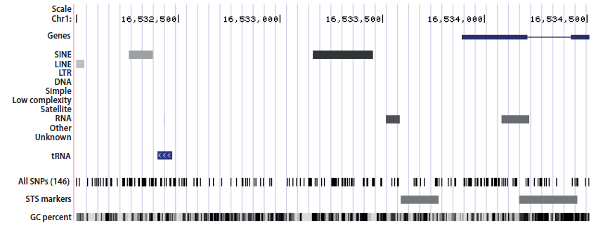
Genome Browsers
This example shows the annotation for human chromosome 1 between nucleotide positions 16,532,000 and 16,534,500, as displayed by the UCSC Genome Browser (redrawn slightly). The user can configure the browser to show many different features of genome annotation. This configuration shows the locations of protein-coding genes, with exons as boxes and introns as lines, various types of repeated DNA sequence, tRNA genes, SNPs, and STS markers. In the bottom panel the GC content is indicated, based on a sliding window of 5 bp.

